Slide 1
ET-NCMP Summary and review of progress
Marrakech March 2018

Slide 2
Terms of Reference
Develop the specifications of the newly defined National Climate Monitoring Products (NCMPs), including for their provision and the associated software requirements, and develop guidance for their operational production and dissemination;
Conduct an assessment of the existing capabilities for national climate monitoring, including through surveys and workshops;
Collaborate with other groups such as the relevant CBS teams regarding the creation, coding, implementation and the exchange of NCMPs, obtain feedback on NCMP implementation from suitable points of contact in NMHSs, and liaise with World Data Centres as appropriate on scientific and technical guidance;
Collaborate with ETCCDI to assess the feasibility of, and provide –if appropriate- a methodology for, combining RClimDex with appropriate gridding software to develop a unified NCMP software package suitable for use on routine basis by the NMHSs.

Slide 3
Specification and Guidance
Develop the specifications of the newly defined National Climate Monitoring Products (NCMPs), including for their provision and the associated software requirements, and develop guidance for their operational production and dissemination

Slide 4
Guidance
Contains basic definitions of the NCMPs, background material and a working example, which corresponds to the software
Finalised July 2017
Peer has more details of progress
Some additional review and a number of questions
Translated into WMO languages

Slide 5
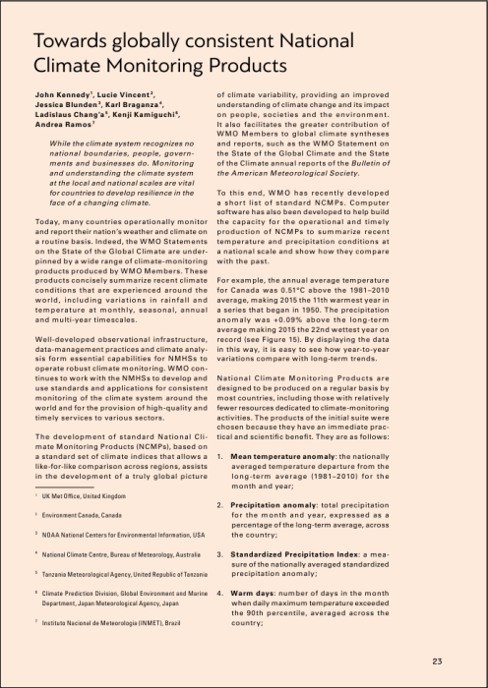
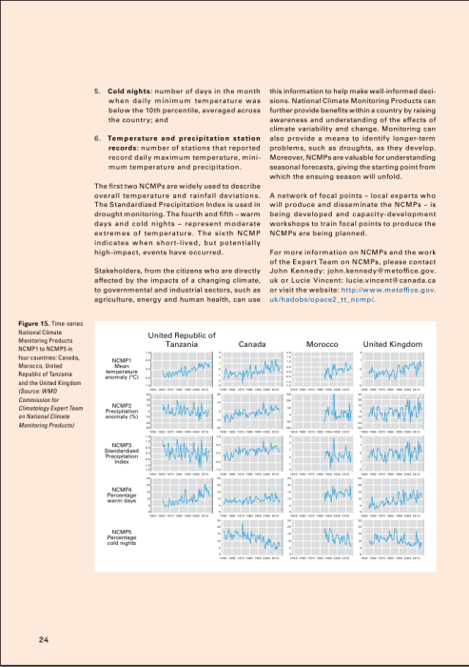
Sidebar in WMO annual statement
Two pages in the WMO annual statement
Good feedback and lots of interest

Slide 6
Surveys and workshops
Conduct an assessment of the existing capabilities for national climate monitoring, including through surveys and workshops;
Survey carried out
Discussed workshops at previous meeting, but timing didn’t work out.
Will discuss this more over the next few days.

Slide 7
Collaborate with other groups such as the relevant CBS teams regarding the creation, coding, implementation and the exchange of NCMPs, obtain feedback on NCMP implementation from suitable points of contact in NMHSs, and liaise with World Data Centres as appropriate on scientific and technical guidance;
At previous meeting in Melbourne, decided to start with simple dissemination via WMO wcdmp@wmo.int

Slide 8
ETCCDI and Software
Collaborate with ETCCDI to assess the feasibility of, and provide –if appropriate- a methodology for, combining RClimDex with appropriate gridding software to develop a unified NCMP software package suitable for use on routine basis by the NMHSs.

Slide 9
Software
Developed software and manuals based no RClimDex
An archive of code is now on github
https://github.com/ET-NCMP/NCMP
Bureau of Meteorology are looking after it long term
Tested within the team
Long list of volunteers to test the code
Still needs some work so that it is “suitable for use on routine basis by the NMHSs.”

Slide 10
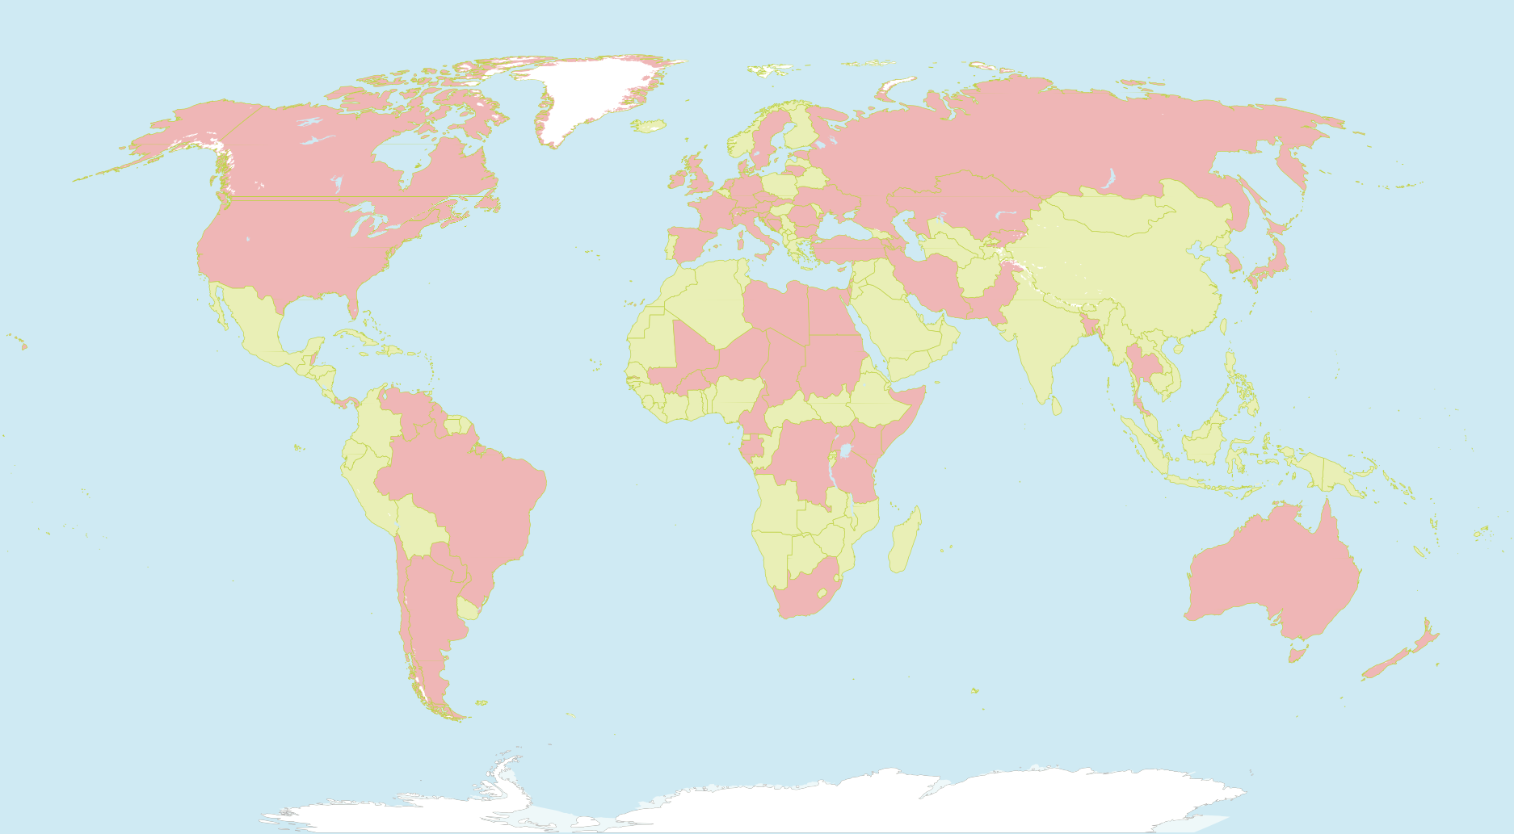
64 Focal Points

Slide 11
SPECIFIC ISSUES

Slide 12
Issues with the software
Problems in P2 handling large amounts of missing data.
Variogram calculation can be tricky – how can we better explain this?
Ladislaus
We tried to include as many stations as possible that meant including stations with many missing data and the results was several Warning Messages and in some occasion the Program stopped particularly when computing the Indices
We Later tried to remove stations with a lot of missing data and the program run smoothly with few Warning Messages and few error message
Computation of the Variogram using All options could not go well and instead we computed the Variogram by running for one NCMP at a time which worked
So we Think Treatment of the Missing Data is the one of the major challenges that need to be addressed and get more clarity including understanding the criteria for the Number of missing data for the station to be excluded from the analysis
It will be useful to document all the Potential Warning and Error messages and the guidance on how to resolve it
Fatima
Generation of "Inf" value for Index 2 in stations with few precipitation (i.e summer) stops progression in calculation (variogram etc.)
When asking calculations for only few stations (among the list included in P0_Station_List or P2_Station_List), we can not select the stations. Calculations are done starting from first station in the list.
When using the P3_Variogram_Interactive program, I didn't find the intermediate variograms to check if they are correct or no; may be because they are printed into the output file at the end (or I missed the right folder).

Slide 13
Issues with software ctd.
Simon
What recommend/default values should be specified for a range of analysis parameters, and how difficult should it be for a casual user of the code to change those parameters. (Since it is Open Source, it is not possible to prevent expert users modifying R code.)
What is the best approach for treating missing data particularly, but not limited to, in the calculation of extremes indices.
Lucie
P1_Quality_Control.R
user defined limits to identify outliers in tmax and tmin. Currently, tmin < -65°C and tmax > 50°C.
Outliers are also identified when tmax (or tmin) is outside of mean + nSD. ET recommends of using 5 SD: however 5 SD identified a lot of values. Should ET recommend 7 SD?
P2_Indices.R
The criteria for calculating monthly and annual values have changed:
monthly values are calculated if # of missing days ≤ 10 days (WMO 2009)
annual values are calculated if # of missing days ≤ 36 days (WMO 2009)
climatology is calculated if there is at least 9 valid years??? (WMO 2009)
(We need the complete reference for WMO 2009)
There is a new calculation done for NCMP6: how is it done? The record is calculated from the first 30 years of data: what if the station length less than 30 years?
P3_Variogram.R
What is the minimum years recommended for variogram? Do we want to suggest using 1 year only? Which year should be used? Are variograms better when more years are used? ET should provide some guidance in the User Manual.
Is the procedure described in Appendix D still valid? Are the points still divided into bins of 20 km and the maximum distance is 3000 km for temperature and 2000 km for precipitation?
The interactive program to produce the variogram is helpful!
Does this procedure work for small countries and small islands? Maybe more testing needs to be done.
P4_Region_Average.R
After entering the 3-digit code, it is mentioned “Calculating variograms for all stations with computed indices. Can change this by editing the file ‘A2_Indices/P2_Station_List.txt”. What does the message mean? Are the variograms re- computed in this program? Why?
P7_Summary.R
A file named “CountryName_NCMP_Summary.csv” should be created in the folder A7_Summary. The user would have to enter the name of the country or region (ex. Canada) and the year for producing the summary (ex. 2015).

Slide 14
Software general issues
Default values – what are they, how hard to change?
Missing data – what is acceptable, too many crashes code
Testing for small nations (New Zealand, Caribbean)
What variogram to use when too few stations?
Documentation of errors/warnings

Slide 15
Software general issues

Slide 16
Discussion points - software
Permanent home and archive for the software
Updating software, manual and guidance
How to handle feedback, bugs, maintenance
What steps need to be taken to make the software available/suitable for distribution
What diagnostics should the code output?

Slide 17
Software other issues

Slide 18
Discussion points - Dissemination
Current plan is for focal points to email WMO upon request.
Further liaison with CBS and RCCs

Slide 19
Discussion points – next steps for NCMP implementation
Finalise software to be released with guidance
What needs to be done?
Who will do it?
Timelines?
Focal points
Follow on Expert Team

Slide 20
Next steps

Slide 21
Finalising Software

Slide 22
Expert Team on Operational Climate Monitoring
Terms of Reference
Provide guidance on the use of remote sensed data for operational use in climate monitoring
Assess the progress and gaps in operationalizing new daily CLIMAT, NCMPs, CCDI through CBS infrastructure (WIS and GDPFS)
Provide guidance to NMHS and RCC on tools, techniques and software for generating datasets and climate monitoring and assessment and related products
Liaise with CBS on the implementation of cataloguing systems for extreme weather, water and climate and related databases
Deliverable
Guidance on the use of satellite and radar data and products (close link with the Space program and GCOS)
Set up, in collaboration with CBS, a process for operationalization and exchange of WWRs, ETCCDI, NCMPs and daily CLIMAT reports
Provide guidance of capacity building aspects including through workshops and RCC engagements
Status report on cataloguing systems for high impact and extreme events

Slide 23
Discussion points – capacity development
Where? Previously discussed SW Pacific/SE Europe
How? Considerations for Pilot workshop
“typical” participants
Existing CDMS, prepared
Language
More complex than ETCCDI
Why? Understand the process
When?

Slide 24
Workshop timeline
Month -X: location, time and local organiser of the workshop are identified
Month -6: WMO contacts PRs to identify participants and trainers. The PRs will be asked whether they are agreeable to the idea of producing NCMPs. Personal contacts might help where these exist (e.g. Pacific islands)
Month -3: contact participants and start the process of data preparation (asking about numbers of stations, data formats, checking software is installed and so on). Ensure visas are being arranged.
Month 0: one week workshop
Month +3: summarise the outcomes of the workshop for CCl, including feedback from participants.
Month +6: follow up with focal points to see how they are working with NCMPs, problems they have had, successes and so on.
During the workshop itself the approximate timeline would be:
Monday: local introduction from host, introduction to NCMPs from trainers, participants would give short introductory presentations, RCC to talk about general challenges they have in monitoring the climate.
Tuesday: quality control, and (anticipating problems with data formats) data wrangling.
Wednesday: calculate indices and variograms
Thursday: interpolation and regional averaging.
Friday: participants produce short presentations (maybe generate a climate bulleting) presenting their results and get a diploma signed byTom Peterson II (or similar).

Slide 25
Capacity Development

Slide 26
Discussion point – focal point
What is the communication strategy
So far, there has been little to communicate
And little for them to do
Guidance and software available soon

Slide 27
Focal points communication strategy

Slide 28
Interactions with other teams
ETCCDI
So far, relatively informal
Other OPACE expert and task teams
Normals, Extremes, Homogenisation
Other groups
Which groups?

