Slide 1


Prithiviraj BOONEEADY
Meteorologist
Mauritius Meteorological Services
Brief Overview of
CM-SAF
&
Possible use of
the
Data for NCMPs

Slide 2
HISTORIC BACKGROUND
  Early 80’s: 1st attempt to generate satellite based long term data series-International Sat Cloud Clim Project(ISCCP)- clim for short wave radiation;
  Followed by Pathfinder Atmosphere(PATMOS) project- Aerosol Optical Thickness (1981-1994);
  SMHI Cloud ANalysis model using DIgital AVHRR data(SCANDIA)- cloud clim over Scandinavia – Cloud Classification (1991-2000) ;
  NASA Water Vapour Project (NVAR)- research and understanding of variability of Earth’s water cycle
  (1988-2001).

Slide 3
CM-SAF
CM-SAF : The Satellite Application Facility on Climate Monitoring
  one of the 8 EUMETSAT’s SAF Network (www.eumetsat.int)
  plays major role in EUMETSAT’s activities towards CM
  Consortium: Germany (leader), Finland, Belgium, Netherlands, Sweden and Switzerland
  Initial Operation Phase in 2004-
    Develop algorithms to derive radiation, water vapour and cloud variables
    Near real products (monthly mean values within 8 weeks after obs)
  Continuous Development and Operations Phase(CDOP)
  2007- 2012)
    Continued development of the algorithms, careful intercalibration of radiances from different sensors (produce long time-series)
  Spatial coverage from regional to global

Slide 4
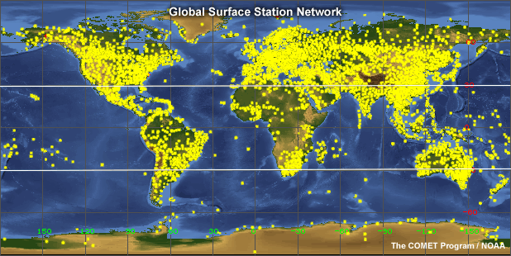
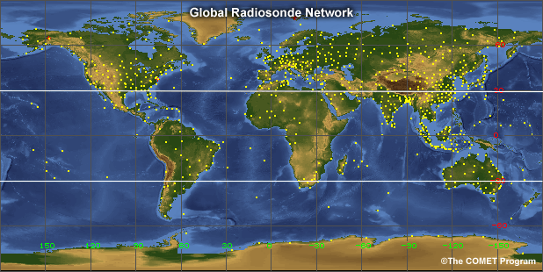
DATA SETs (ground-based)
Highly accurate (if ground stations are well maintained)
Important – used to validate and calibrate satellite data
However
Patchy
(dense over land, sparse mainly over ocean)
Even worse for upper-air observation
http://www.eumetrain.org/resources/climate_saf_2011.html
Christine Träger-Chatterjee and
Jörg Trentmann

Slide 5
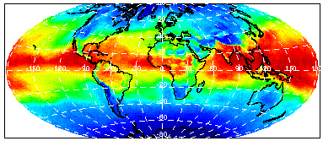
DATA SETs (satellite)
Lot of climate processes over ocean (not covered by ground obs)
Satellite provide a more complete picture + measures parameters @ TOA.
Monitor entire globe (polar orbiting sat)
Monitor field of whole disk (geostationary sats)
http://www.eumetrain.org/resources/climate_saf_2011.html
Christine Träger-Chatterjee and
Jörg Trentmann

Slide 6
DATA SETs
Two types :
Near real time (express) data set
Operationally generated on a monthly basis
First-order satellite calibration is considered
Not homogeneous over time
Resulting time series can be used for monthly climate bulletins, but not applicable for all climate monitoring purposes (e.g. trend estimation)
Carefully inter-calibrated data set
Generated on an irregular basis, e.g. every two years
Calibrated and homogenized satellite data are applied
Homogeneous over time
Resulting time series should be fully applicable for climate monitoring (e.g. trend estimation, anomalies)

Slide 7
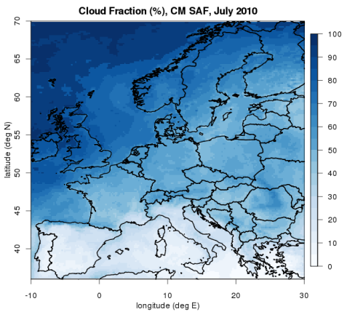
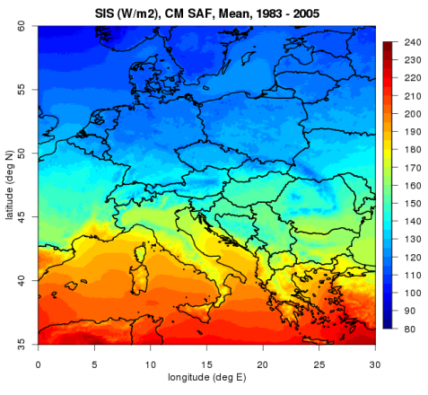
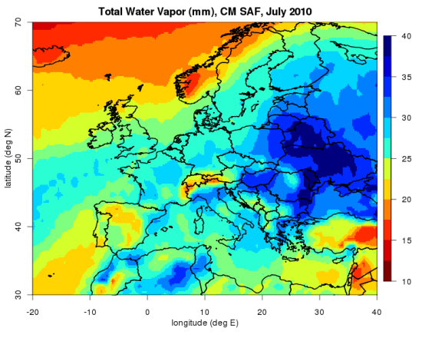
A few list of express data set
(source :CMSAF)
Generated within 8 weeks
Cloud
  Include cloud fraction, optical depth
daily and monthly mean, since 2005 @ 15km×15km
Compared to surface obs, diff only < 10%
Radiation Parameters
  Surface Solar Irradiance (SIS) and thermal radiation
daily and monthly means, since 2007 @ 15km×15km
Compared to surface obs, diff only 10 W/m²
Water vapour
  globally and over ocean
daily and monthly mean , since 2004 @ 90km×90km
Compared to radiosondes, diff only 4 kgm⁻²
Full list of products available from www.cmsaf.eu

Slide 8
Few Carefully intercalibrated data set (Source : CM SAF)
Needs approximately 2 to 3 years
Water Vapour- Hamburg Ocean Atmosphere Parameters and Fluxes from Satellite (HOAPS) data set
  Integrated water vapour over ocean
monthly mean & 6hrly component, 1987-2005 @ 0.5º resolution (available)
  Precipitation over ocean
monthly mean, 1987-2008 @0.5º resolution (available)
Radiation Parameters
  Global dataset for Solar Irradiation
daily and monthly means, 1989-2008 @ 0.25º resolution (available spring 2012)
  Surface Incoming Surface(SIS) radiation
hourly, daily and monthly mean, 1983-2005 @ 0.03º resolution (available)
Global data set for Cloud Coverage
monthly mean , 1989-2009 @ 0.25º resolution (available spring 2012)

Slide 9
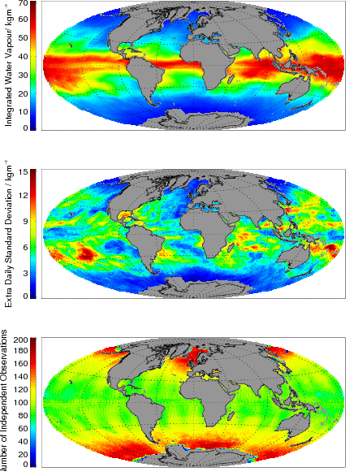
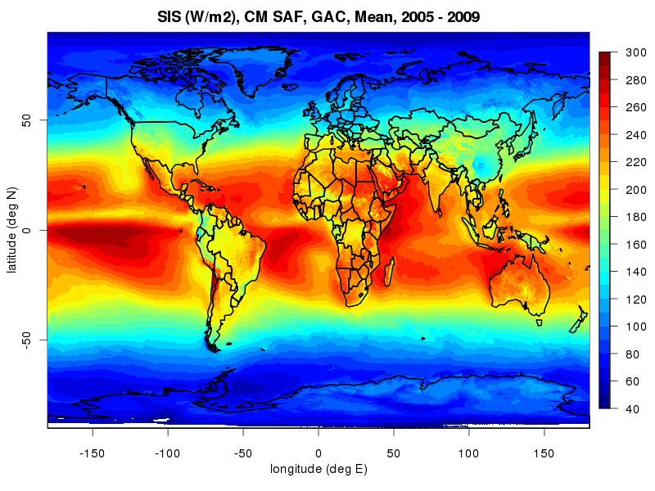
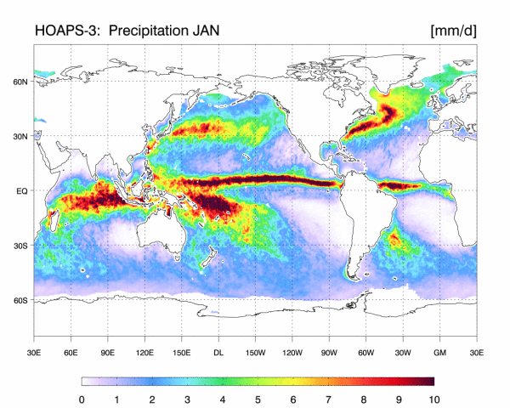
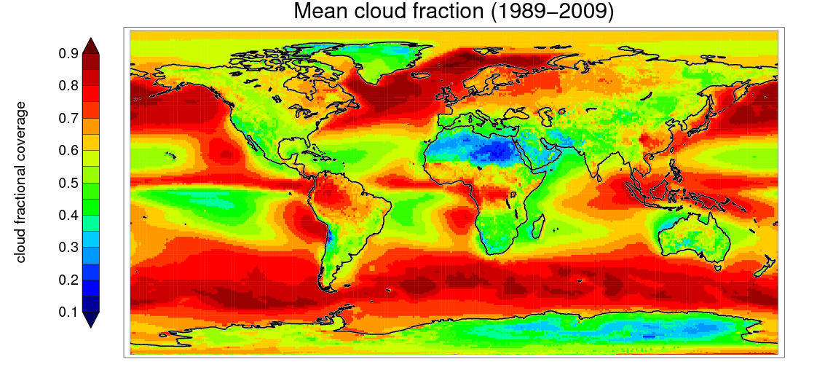
Carefully inter-calibrated data set (Source : CM SAF)
Integrated water vapour over ocean
Surface Incoming Solar Radiation
Precipitation over ocean
Cloud coverage

Slide 10
Future Plans
extensions of the HOAPS data set may include an updated input data base or changes in homogenisation and/or retrieval schemes, i.e. from HOAPS to HOLAPS.
start of CM-SAF’s CDOP2 in spring 2012 with more focus to water cycle which will improve the usefulness of the products, provide a clear sky flux, provide globally balanced product, extend the time period and enlarge the area.
setting up of the GEO ring to monitor the whole earth.

Slide 11
Recommendations
Satellite products could be used to monitor the climate in data sparse areas such as the Oceans and some regions over land (e.g. Africa, polar and desert regions). In addition, they supplement ground based measurements, e.g. improve spatial interpolation of ground stations (enhance resolution of regional effects)
The Surface Incoming Solar (SIS) radiation product has a wide range of applications in for example solar energy, climate monitoring and climate trend analysis. SIS from the satellite could be included in our list of the national climate monitoring products.
T h a n k y o u !

