Slide 1


Prithiviraj BOONEEADY
Meteorologist
Mauritius Meteorological Services
Overview of
ETCCDI
&
Production of NCMPs

Slide 2
ETCCDI
CCL/CLIVAR/JCOMM-Expert Team (ET) on Climate Change Detection and Indices (ETCCDI) + its predecessor CCL/CLIVAR WG on Climate Change Detection
  Coordinate international effort to develop, calculate and analyze indices which individual countries and regions can calculate in exactly the same way;
  Study the changes in the temperature and precipitation extremes.
  HOW?
  develop a comprehensive list of indices meaningful over the globe
  coordinate workshops for the preparation of climate change indices.

Slide 3
Last decade workshops
Central and East Africa, Caribbean, South America, Middle East,
Central, South Asia and South East Asia and South Pacific
October 2009- organised by COI under ETCCDI format @ Regional Meteorological Training and Research Centre for the Indian Ocean, Mauritius Meteorological Services (Experts– Lucie Vincent , Enric Aguilar)
2 Participants from the following countries: République des Comores, République de Madagascar, Republic of Mauritius, La Réunion (France) and Peoples Republic of Seychelles.
[Citation: Vincent, L. A., et al. (2011), Observed trends in indices of daily and extreme temperature and precipitation for the countries of the western Indian Ocean, 1961–2008, J. Geophys. Res., 116, D10108, doi:10.1029/2010JD015303.]

Slide 4
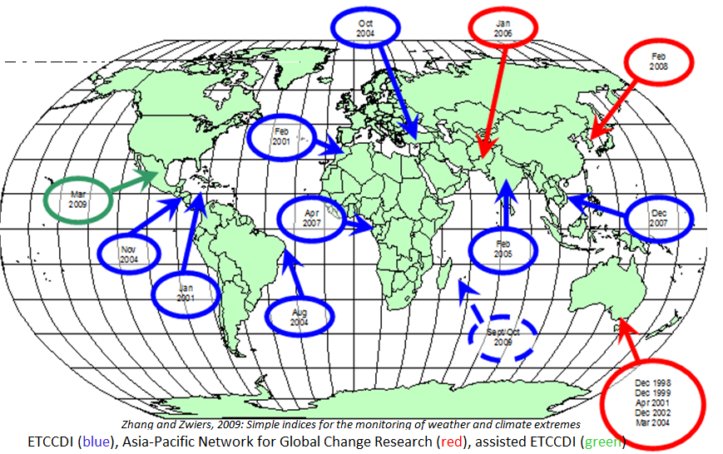
Previous Wkshps

Slide 5
Data
Participants brought digital long term (1961-2008) daily maximum and minimum temperature and precipitation data
The data period varied but sufficient (32 stations) to compute 1961-2008 trends.

Slide 6
Methodology
Monthly mean temperature and monthly total precipitation time series were examined for homogeneity using the software package RHTestsV3 (Environment Canada).
Adjustments were applied to 9 and 10 stations (Tx & Tn)
Rainfall data were not adjusted.
For WIO, 13 temperature and 8 precipitation indices (on annual basis) were appropriate.
Daily temperature and rainfall data were quality controlled using RClimDex (Environment Canada).

Slide 7
Indices definition (WIO)

Slide 8
Trends
Trends in annual means of daily maximum temperature (TXMean)
Trends in annual means of daily minimum temperature (TNMean)

Slide 9
Trends in extremes
Sig. increase of 15 to 20% in the percentage of warm days (TX90P) and warm nights (TN90P)
Sig. decrease of 10 to 15% in the percentage of cold days (TX10P) and cold nights (TN10P).

Slide 10
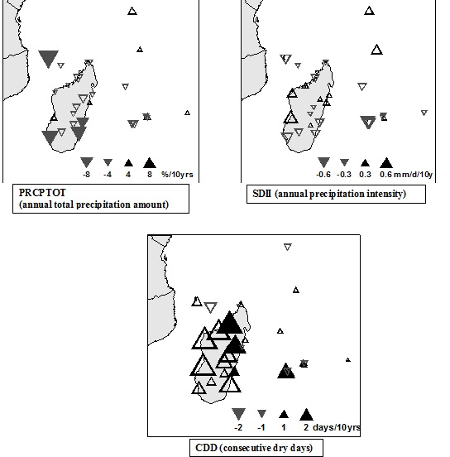
Decadal Pptn trends
Annual precipitation has decreased by 2.76% per decade

Slide 11
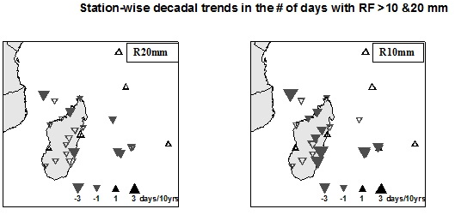
Decadal trends in Pptn extremes

Slide 12
Production of NCMPs
Host Regional Workshops with climate experts from NHMS
Process standard long term daily data >30yrs (different countries)
Use software packages
Increase understanding of regional Climate Change and strengthen regional cooperation on research
Ensure that NHMS maintain homogeneous climate data
Encourage the publication of Scientific Papers by participants
T h a n k y o u

