Slide 1
BASIC APPROACH TO CLIMATE MONITORING PRODUCTS AND
CLIMATE MONITORING PRODUCTS IN WMO RA VI
Mesut DEMIRCAN
Geodesy and Photogrametry Engineer
Turkish State Meteorological Service
Agrometeorology and Climatological Observation Department
Climate and Climate Change Division
e-mail: mdemircan@dmi.gov.tr

Slide 2
The Climate for Whose:
Climate products, has different meanings for the users from every sector. For this reason, each user community tends to a different product. For example, scientists interested in such climate products which consist of climate variability from past to present, oscillation range and the extreme conditions, comparison of past, present and the future climate conditions. In this context, products; which shows oscillation and changes in climate, comparing with today's climate and long term normal as monthly and annual assessment in local and global scale with the standard time periods and what is the climate and climatic parameters from the beginning of the world, are used in scientific studies.

Slide 3
The Climate for Whose:
Public and sectorial user community show more interest in another class of climate products such as seasonal and monthly forecasts and the secondary climate products such as cooling and heating degree days, heat index and drought and so on and they use these products for planning their works. For example, ‘What will happen’ is very important than ‘What happened’ for the energy sector to plan future energy use and agricultural sector to plan stages of agricultural production. However, sectors such as insurance especially interest in records of extreme weather events when they occurred. And also long term climate data are demanded by sectorial user while planning and building industrial plants, solar and wind energy farms, dams, airports and so on.

Slide 4
The Climate for Whose:
This issue can be seen also in recommendations of Fifteenth session of the Commission for Agricultural Meteorology (CAgM) “the Commission recommended the implementation of tools and services aimed at multiple stakeholders and for assisting with risk management. Tools and services should address long-term (strategic), seasonal (tactical) and short-term (operational) forecasting and the distinct differences between these services. Service delivery should assume a basic minimum access to ICT and should build up from the minimum in a progressive manner (paragraph 4.27 WMO-No. 1062)”.
Prediction products of global and regional climate models are used mostly by scientists and decision-makers, governments, intergovernmental and international structures for one or more decadal planning.

Slide 5
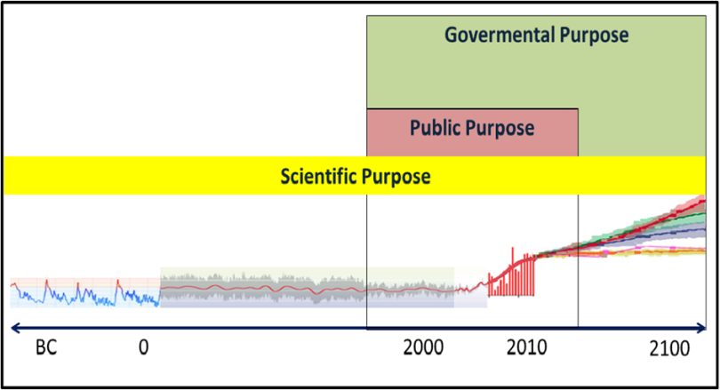
Users for climate monitoring products.

Slide 6
The Climate Features:
Standard Period:
In order to speak on climate, first of all, it is required to have observations of climate variables and series of observed climate variables. Reliable data sets are needed to make accurate climate analysis. If we make this analysis on a large scale such as countries, continents and the world, it needs to use the standard periods, and i.e. observations must have a common period.
It is one of challenges in climate analyzes from the early and mid1800's to today which instrumental observations began in, both the lack of global distribution and adequate number of observation stations and continuously changing in measurement systems. There are useful studies to overcome from these difficulties to derive climate data base such as tree rings, isotope techniques etc. which are methods the paleo-climatology, and also data recovery efforts, satellite climatology, re-analysis products of forecasting models.

Slide 7
The Climate Features:
Standard Period:
On the other hand, there are difficulties in using the standard periods due to the climate observations have not begun at same times in every country. Moreover, observation network may not be operated and observations may be interrupted because of the economic challenges, wars, and political turmoil and so on. However, the standard periods of 1961-1990, 1971-2000 or 1981-2010 can be used together with or separately according to most common period inside of countries.
In case of selecting one of these standard periods, it must be drawn attention of National Meteorological Services to the importance of preparing of a homogeneous data sets for selected period. Another tool for normal’s data sets of the standard period may be database which derived from re-analyzed data sets or model outputs.

Slide 8
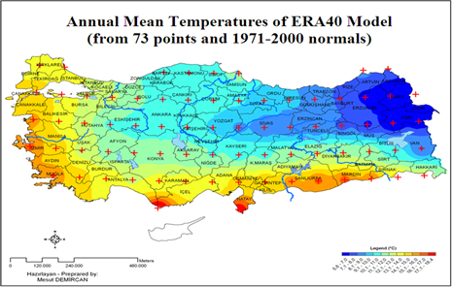
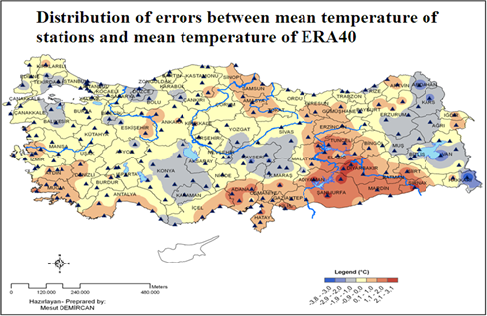
1971-2000 average temperature of ERA40 re-analysis data set of the European Centre for Medium-Term Weather Forecasts (ECMWF) which has created for the Turkey and differences between observations. ERA40 has been produced from different sources of meteorological observations by the ECMWF Integrated Forecast System (IFS) (which have 1,125° (~125km) resolution and topography ranging from50m to 2500m for Turkey)(Demircan, M. and Friends, 2011).

Slide 9
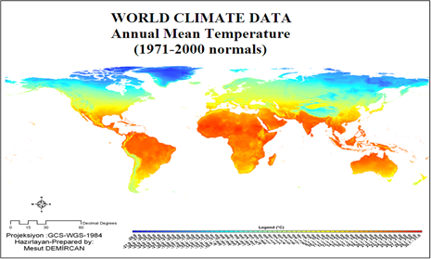
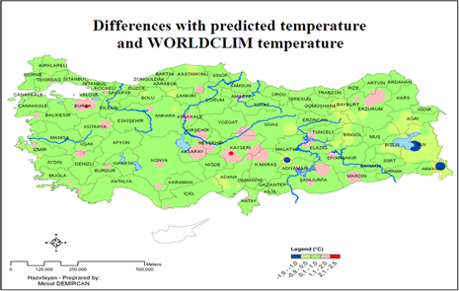
1971-2000 average temperature of Global Climate Data (WorldClim) and differences between predicted temperatures for Turkey(which have 30 arc second (~1km) resolution and topography ranging from 0–3730m for Turkey)(Global Climate Data; http://www.worldclim.org) (Demircan, M. and Friends, 2011).

Slide 10
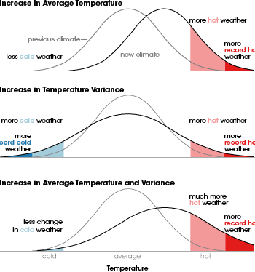
Climate Products Features:
While analyzing of a climate parameter; must be evaluated together with the normal period, the normal value, deviation of the normal value, the lowest and the highest value. For example, while analyzing temperatures of a month or a year, it can be seen normal trend in temperature but also it can consist of extreme cold or heat at same time. If we produce only temperature normal product we do not make a true assessment for temperature. Nevertheless, that appears in recent years, a month can be seen arid after heavy rains which fall down in one or two days with above normal. In today's general findings, while temperature and precipitation do not show an excessive increase in their normal, they show an increase in their extreme events.
Increase in average temperature, temperature variance and together (http://hot-topic.co.nz/when-the-rain-comes/)

Slide 11
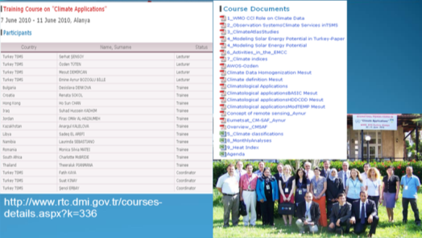
Climate Products Training and Tools:
Training of climate services personnel, it has got great importance for national and global climate observations and climate monitoring products. In this regard, WMO Regional Training Centers (WMO RTC) can be used to provide training for climate service of NHMSs. Through this training, climate monitoring products can gain a standard format in all NHMSs. In this process, WMO must take an active role both training of RTC trainer, supplying of training document to RTC and providing financial support to trainees in developing or least developed countries.
Training course on Climate Applications was held in 7 June 2010 in WMO RTC Alanya Facility, Antalya, Turkey by TSMS.

Slide 12
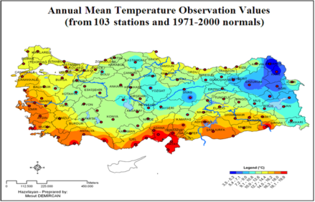
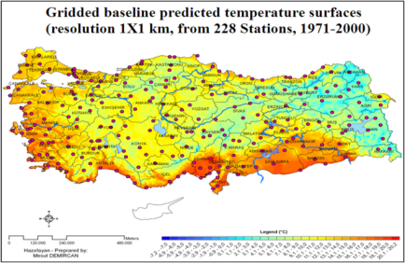
Climate Products Training and Tools:
Today, there are many tools that climate monitoring products can be made with them. Especially, programs that produced under the name of Geographic Information Systems (GIS), are more skilful to make simple climate monitoring products as well as detailed product through modelling. WMO must take an active role supplying of program and it’s training to developing or least developed countries. There is large number of GIS and mapping programs and model that leads to produce maps in many different formats. So it needs identification of the standard format for digital maps.

Slide 13
Recommendations for Climate Products:
1 - National and global assessments must be done with comparing standard normal, and must be consisted extreme values since the beginning of the observation .
2 – To be used products and analysis by national and global users, presentation should be made with at least one UN official language as well as the national language. The second language should be preferably in English.
3 -It must be developed a common language between among climate services and users for climate monitoring products. CMPs must be promoted according to requirements of users such as mentioned in CAgM’s report “As for regional climate change and variability impacts, the Commission acknowledged the need to standardize and adopt climate impact assessments at a regional level in order to identify common issues and find common solutions and comparable results e.g., impact of high temperatures on emergence and growth cereal crops (paragraph 4.74 WMO-No. 1062)”.

Slide 14
Recommendations for Climate Products:
4 - Monthly and yearly analysis should be made containing at least temperature, rainfall and extreme events with extreme values. Essential climate variables which are recommended by WMO may also be useful to the entire analysis.
5 - Climate products must be supported by secondary products such as climatic indices, heating and cooling degree days, heat index and drought.
6 - Monthly and annual climate monitoring products and reports must be shared immediately with the Regional Climate Centers (RCC).
7 - Monthly and seasonal climate forecasts should be done by climate service or RCC products can be used directly or with increasing the resolution of products. RCC and developed prediction centers must be take active role to support national climate services in their region and to help them to improve national climate forecast products.

Slide 15
Recommendations for Climate Products:
8 - Global and regional climate models must be operated by RCC leadership and must be shared with the member countries. RCC and the member countries should assist efforts to increase the resolution for their own regions.
9 - Climate monitoring products must be serviced in digital map formats such as raster, netcdf or shape formats as well as picture format to users. So users can use easily in their own works.

Slide 16
Climate Monitoring Products in WMO RAVI:
There are 50 member countries in the WMO VI. Regional Association, which are mostly in Europe. Internet sites of these countries were examined. It cannot be reached website of 3countries which are Albania, Lebanon and Syria. During the research, Google translator was used if countries have a website with only their own language.
Language:
Inside of these countries; 15 countries have a website only in their own language, 22 countries have a website in 2 languages, 6 countries have a website in 3 languages and 2 countries have a website in 4 languages .

Slide 17
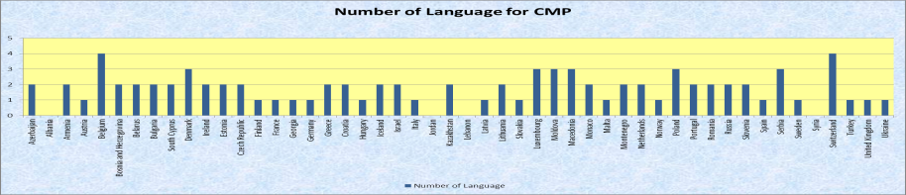
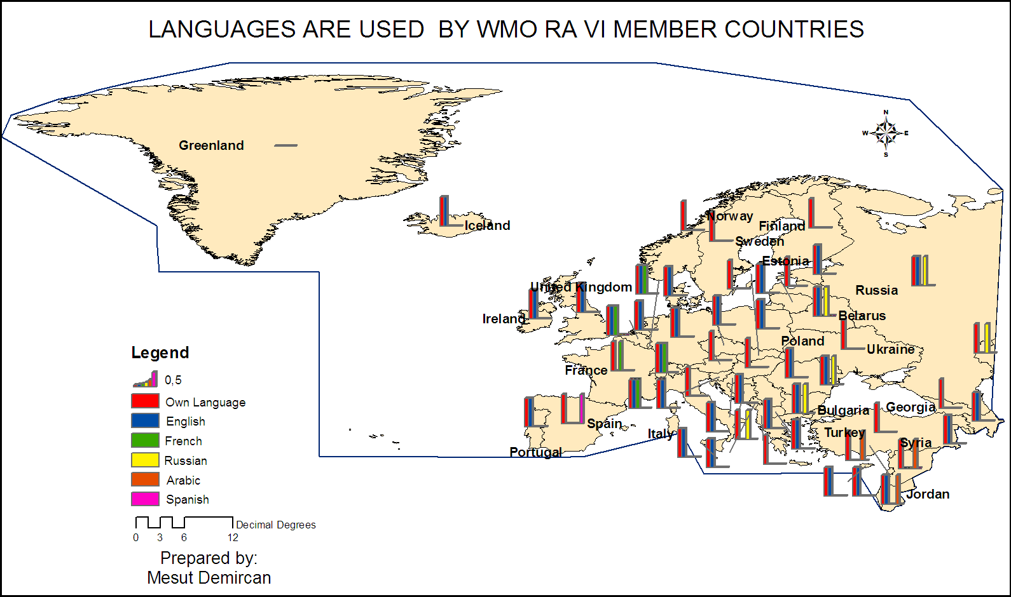

Slide 18
CMP’s Long Term Period (Standard Period) in
WMO RA VI:
Long term period (Standard Period) for climate monitoring products are used in countries is as follows. 3 countries do not use the standard term. 3 countries use 1961-1990 period for the standard period. 9 countries use 1971-2000 period for the standard period. 3 countries use both as 1961-1990 and 1971-2000 periods for the standard period. The standard period of 22 countries cannot be identified from website

Slide 19
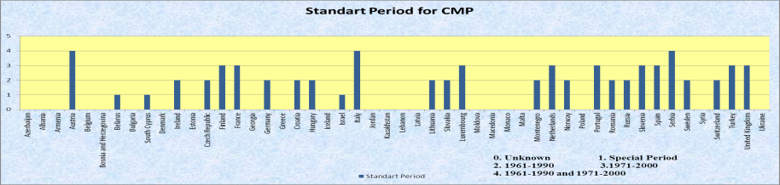
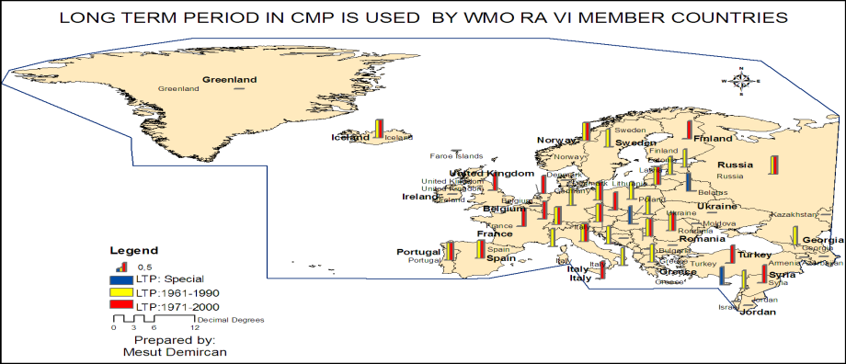

Slide 20
CMP’s Products in WMO RA VI:
Table, report, data, graphic, map and bulletin tools of CMPs are used in countries website in WMO RA VI. Table presentation is used in 2 countries. Report is used in 22 countries. Data presentation is used in 22 countries. Graphic presentation is used in 29 countries. Map presentation is used in 29 countries. Bulletin presentation is used in 4 countries.

Slide 21
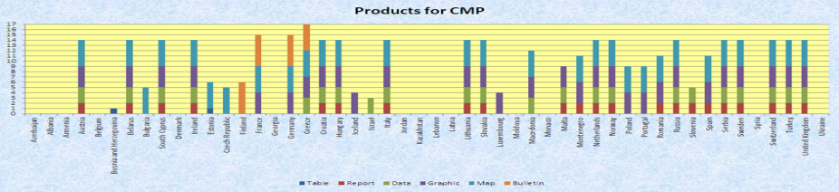
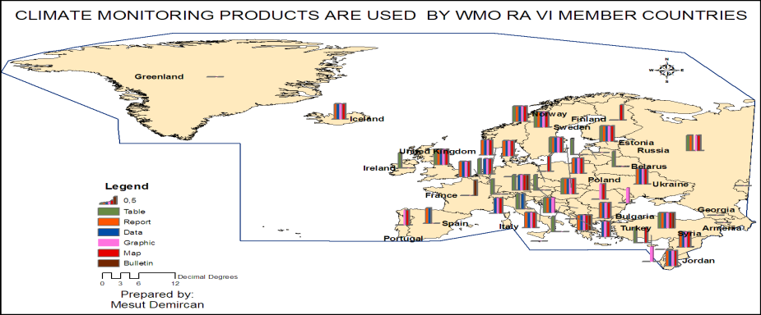

Slide 22
Climate Variables Presented in CMP’s Products in WMO RA VI:
Temperature, precipitation, wind, sunshine duration, radiation, snow are climate variables and extreme events and seasonal forecast are presented in countries website in WMO RA VI. Temperature is presented in 30 countries. Precipitation is presented in 29 countries. Wind is presented in 10 countries. Sunshine duration and radiation are presented in 4 countries. Snow is presented in 3 countries. Humidity and Extreme events are presented in 5 countries. Seasonal forecast is presented in 1 country .

Slide 23
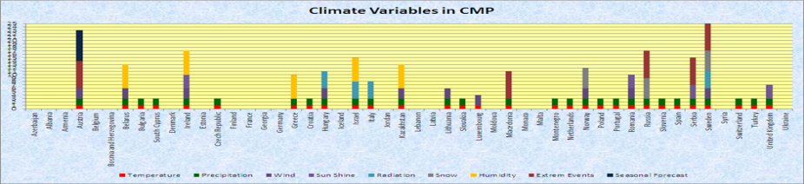
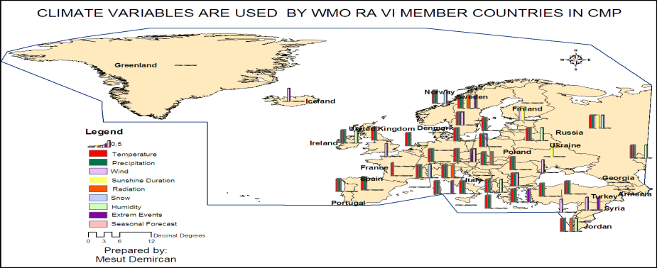

Slide 24
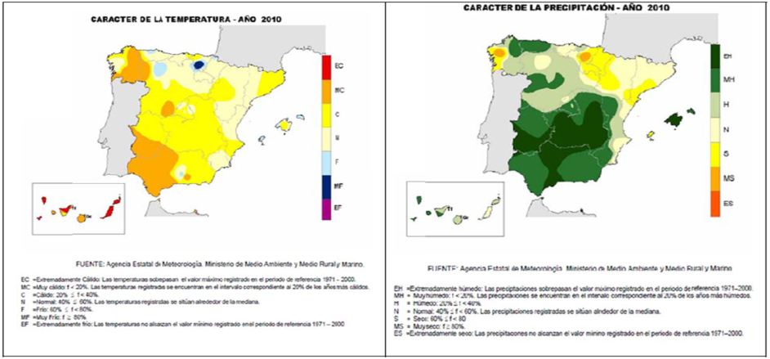
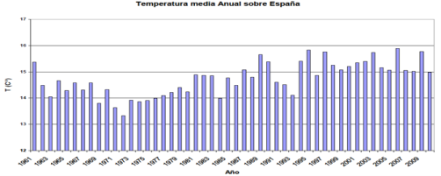
E.5 CMP’s Products Samples in WMO RA VI:
Spanish Meteorological Service (AEMET)
(http://www.aemet.es/documentos/es/elclima/datos_climat/resumenes_climat/anuales/res_anual_clim_2010.pdf)
Temperature graphic, Temperature and Precipitation maps from AEMET Climate in 2010 Report

Slide 25
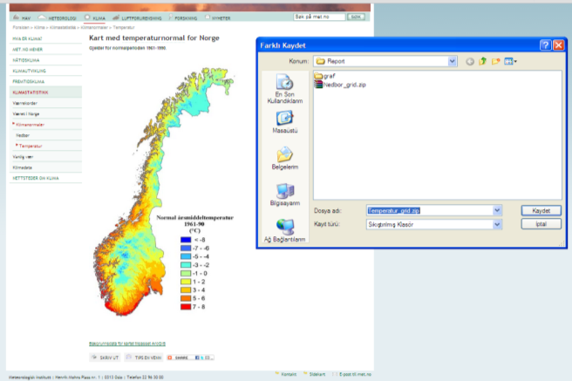
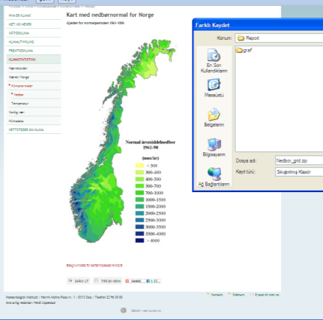
Norwegian Meteorological Institute
(http://met.no/Klima/Klimastatistikk/Klimanormaler/?module=Articles;action=ArticleFolder.publicOpenFolder;ID=390)
Temperature and Precipitation maps from Norway

Slide 26
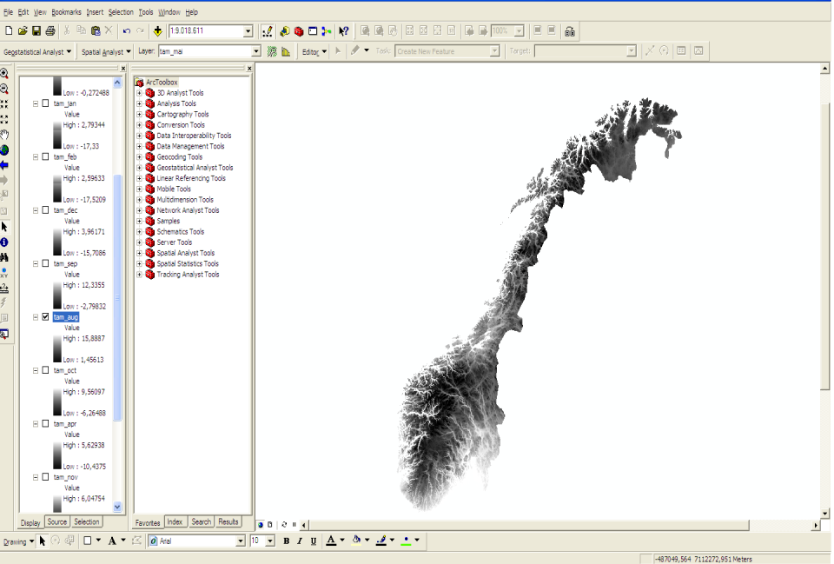

Slide 27
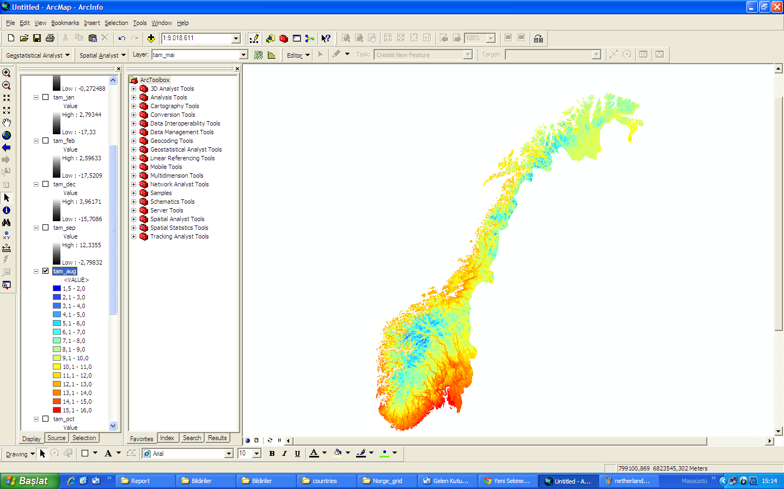

Slide 28
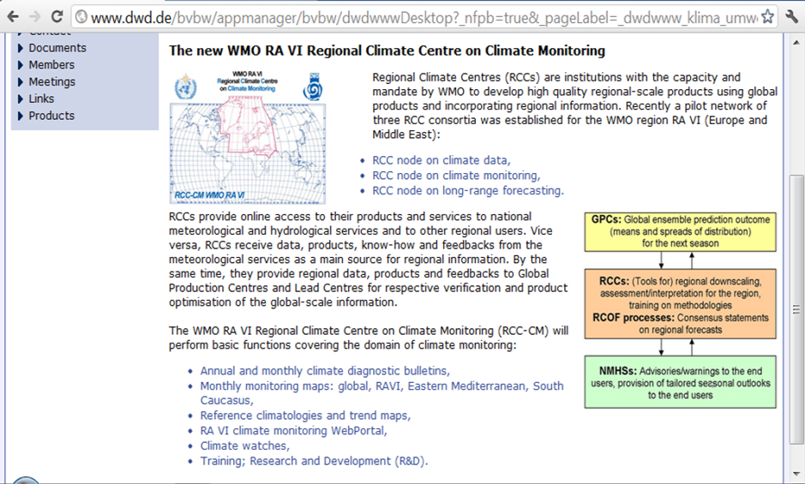

Slide 29
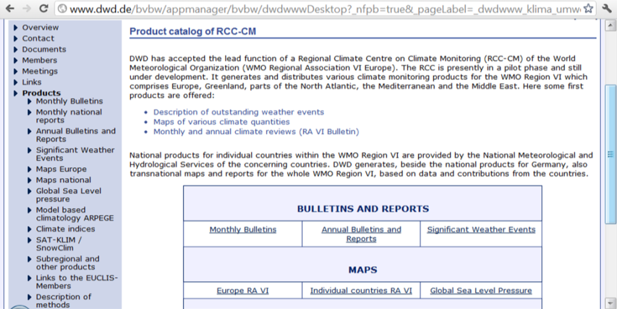
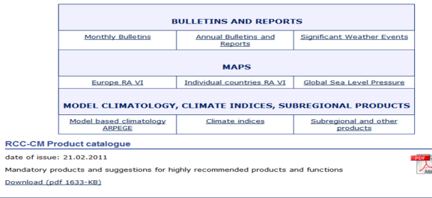

Slide 30
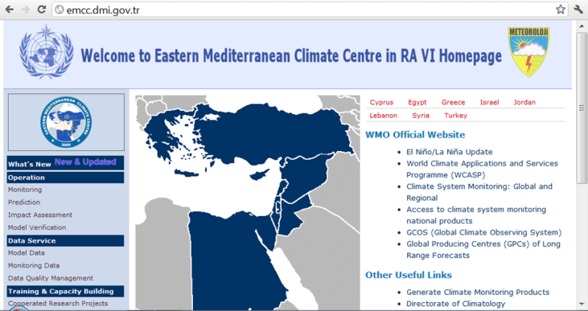
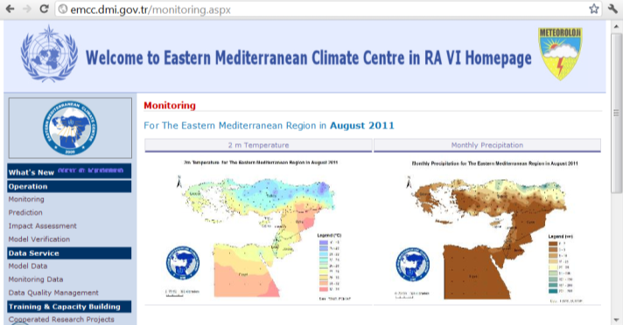

Slide 31
BASIC APPROACH TO CLIMATE MONITORING PRODUCTS AND
CLIMATE MONITORING PRODUCTS IN WMO RA VI
THANKS YOUR ATTENTION
Mesut DEMIRCAN
Geodesy and Photogrametry Engineer
Turkish State Meteorological Service
Agrometeorology and Climatological Observation Department
Climate and Climate Change Division
e-mail: mdemircan@dmi.gov.tr

