Slide 1
Winter 2020-26 LVP Forecast Verification:
LL, KK, GW, SS, GD & CC
NATS Met Office Team

Slide 2

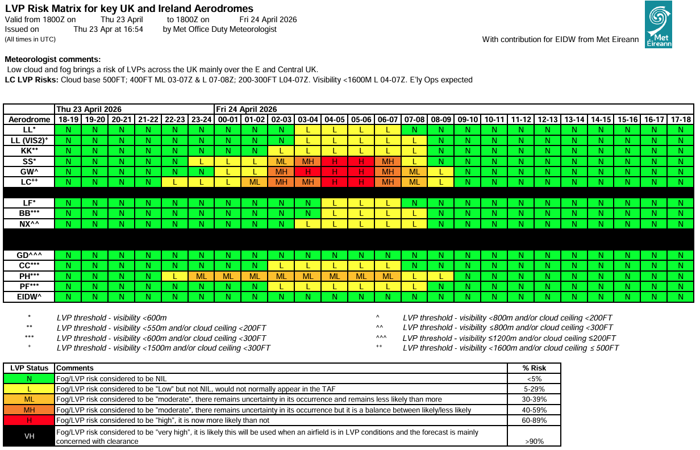
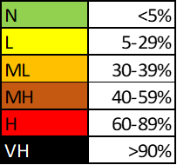
Met Office NATS LVP Matrix
Issued twice daily:
  0320 L
  1710 UTC
Consistent with TAFs at time of issue.
Amendable for LTMA airfields.
Skilful tolerances:
www.metoffice.gov.uk © Crown Copyright 2026, Met Office

Slide 3
2020-2026 Combined Verification Statistics
Manual LVP verification is completed daily by the onsite Met Office NATS team between 1st September and 30th April.
The LVP matrix is only verified between 0400-1800 UTC.
The LVP verification only assesses the original issue of the AM or PM LVP matrix. Any amendments are not considered.
The following tables and graphs show the overall LVP verification results for the previous six winter seasons, from 2020/2021 through to 2025/2026.
www.metoffice.gov.uk © Crown Copyright 2026, Met Office

Slide 4
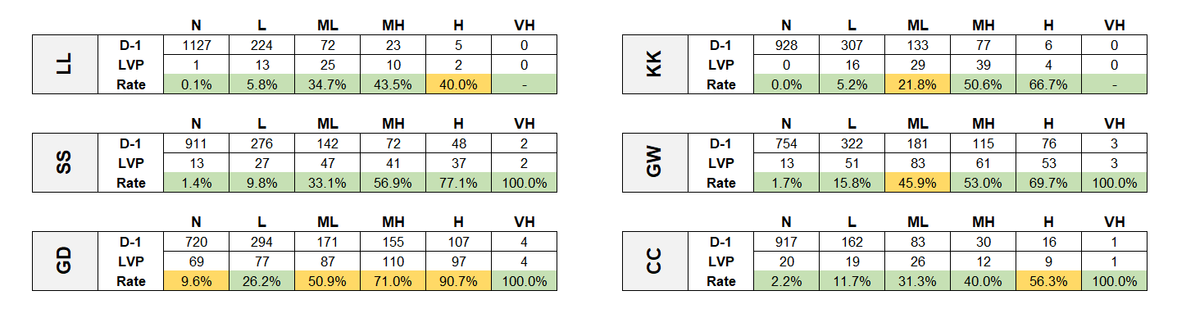
2020/2026 D-1* Verification
Key:
LVP occurrence rate within forecast frequency limits
*1710 UTC Issue of LVP matrix day before
LVP occurrence rate not within forecast frequency limits
www.metoffice.gov.uk © Crown Copyright 2026, Met Office

Slide 5
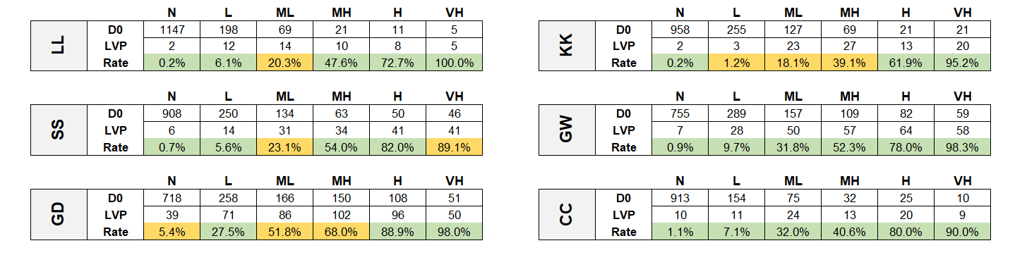
2020/2026 D0* Verification
Key:
LVP occurrence rate within forecast frequency limits
*0320 L Issue of LVP matrix
LVP occurrence rate not within forecast frequency limits
www.metoffice.gov.uk © Crown Copyright 2026, Met Office

Slide 6
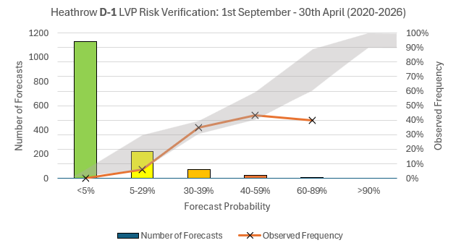
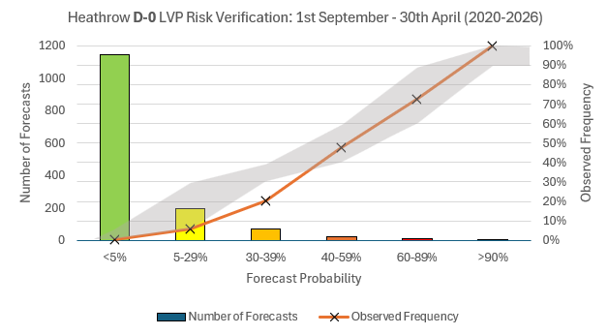
Heathrow D-1 and D0 Graphs
LVP threshold:
Visibility <600 M
51 LVP events recorded within verification timeframe since 2020.
www.metoffice.gov.uk © Crown Copyright 2026, Met Office

Slide 7
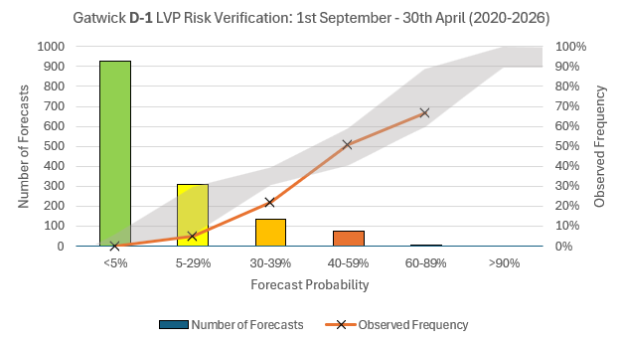
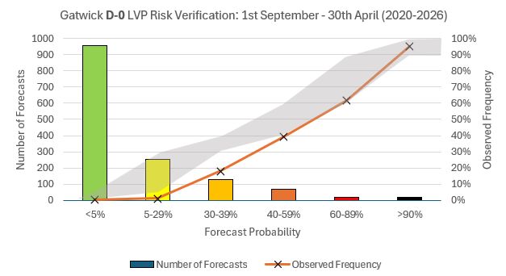
Gatwick D-1 and D0 Graphs
LVP threshold:
Visibility <550 M
Cloud ceiling <200 FT
88 LVP events recorded within verification timeframe since 2020.
www.metoffice.gov.uk © Crown Copyright 2026, Met Office

Slide 8
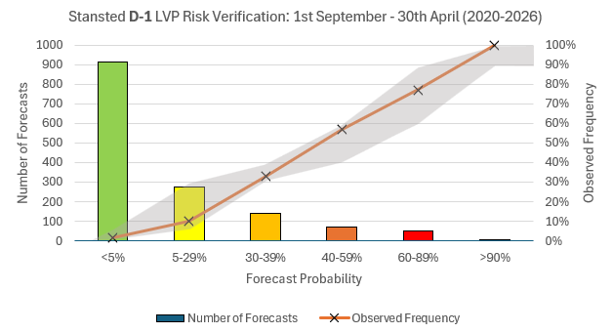
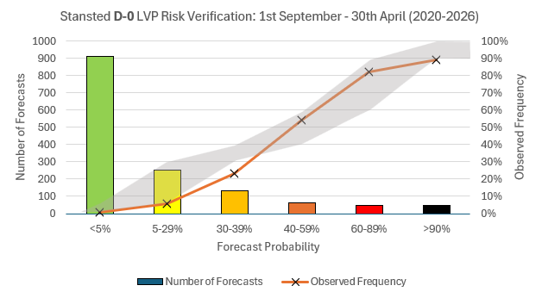
Stansted D-1 and D0 Graphs
LVP threshold:
Visibility <600 M
167 LVP events recorded within verification timeframe since 2020.
www.metoffice.gov.uk © Crown Copyright 2026, Met Office

Slide 9
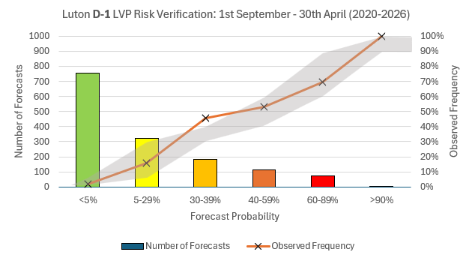
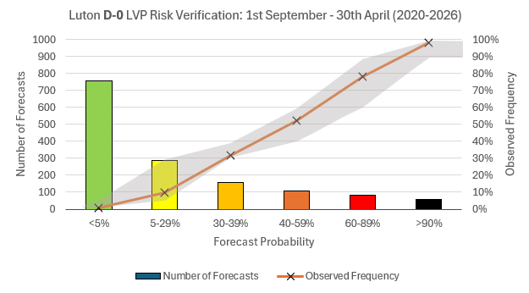
Luton D-1 and D0 Graphs
LVP threshold:
Visibility <800 M
Cloud ceiling <200 FT
264 LVP events recorded within verification timeframe since 2020.
www.metoffice.gov.uk © Crown Copyright 2026, Met Office

Slide 10
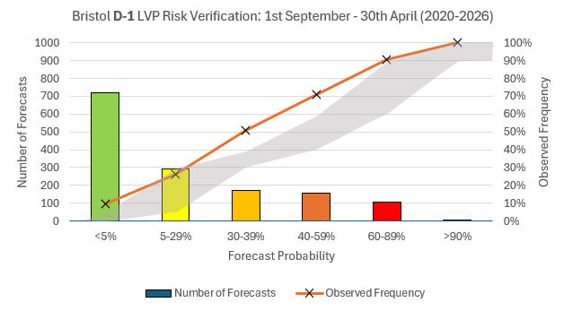
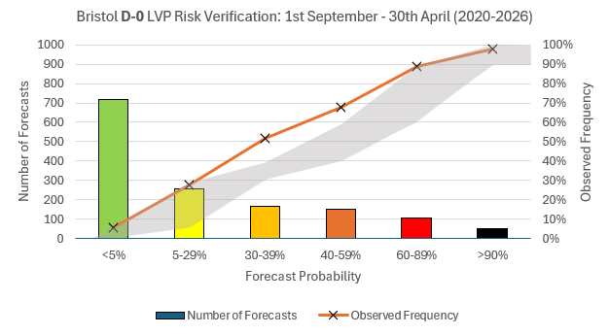
Bristol D-1 and D0 Graphs
LVP threshold:
Visibility ≤1200 M
Cloud ceiling ≤200 FT
444 LVP events recorded within verification timeframe since 2020.
www.metoffice.gov.uk © Crown Copyright 2026, Met Office

Slide 11
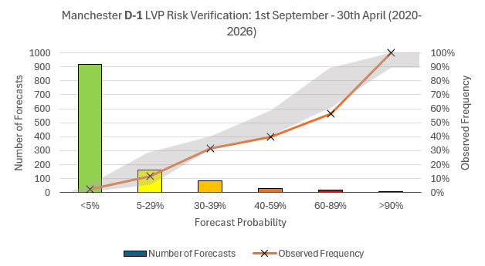
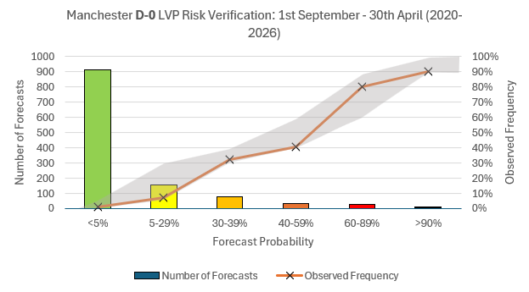
Manchester D-1 and D0 Graphs
LVP threshold:
Visibility <600 M
Cloud ceiling <300 FT
87 LVP events recorded within verification timeframe since 2020.
www.metoffice.gov.uk © Crown Copyright 2026, Met Office

