Slide 1

Climate monitoring aspects within OPACE II ToRs and expected outcomes from ET-NCMP
Fatima Driouech, OPACE 2 Co-chair
ET-NCMP meeting, Marrakesh 15-17 September 2015

Slide 2
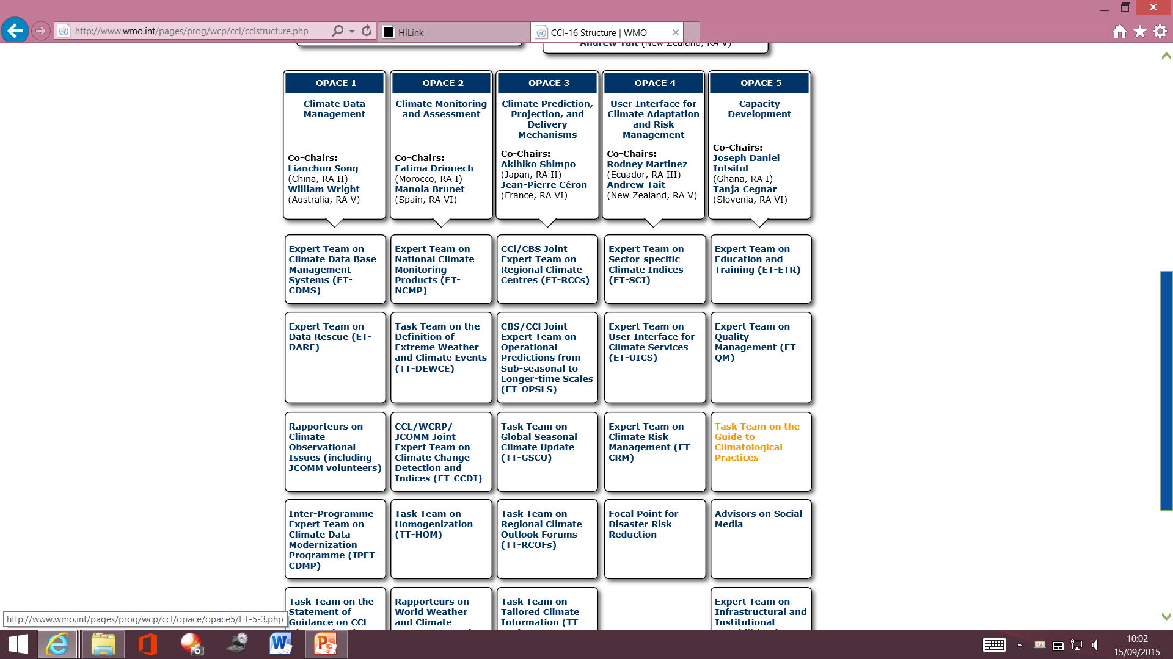

Slide 3
ET-NCMP contribution withing OPACE 2 ToRs
To improve methodologies and standards for defining extreme weather ands climate events that are of major societal impacts, develop standards for creating global, regional and national databases on extreme weather and climate events, improve the WMO Climate Monitoring System and the implementation of Climate Watch Systems at the regional and national levels, with the provision of guidance on the content, dissemination and related alert systems.
Its activities include the development of guidelines on methodologies and standards for defining extreme weather and climate events

Slide 4
OPACE 2 Structure
Expert Team on National Climate Monitoring Products (ET-NCMP)
Task Team on Definitions of Extreme Weather and Climate Events (TT-DEWCE) ➔ link with ET- NCMP
Joint CCl/WCRP/JCOMM Expert Team on Climate Change Detection and Indices (ET-CCDI) ➔ link with ET- NCMP
Task Team on Homogenization (TT-HOM) ➔ link with ET- NCMP
Rapporteurs on World Weather and Climate Extreme Records
Task Team on the Use of Remote Sensing Data for Climate Monitoring (TT-URSDCM)➔ link with ET- NCMP?

Slide 5
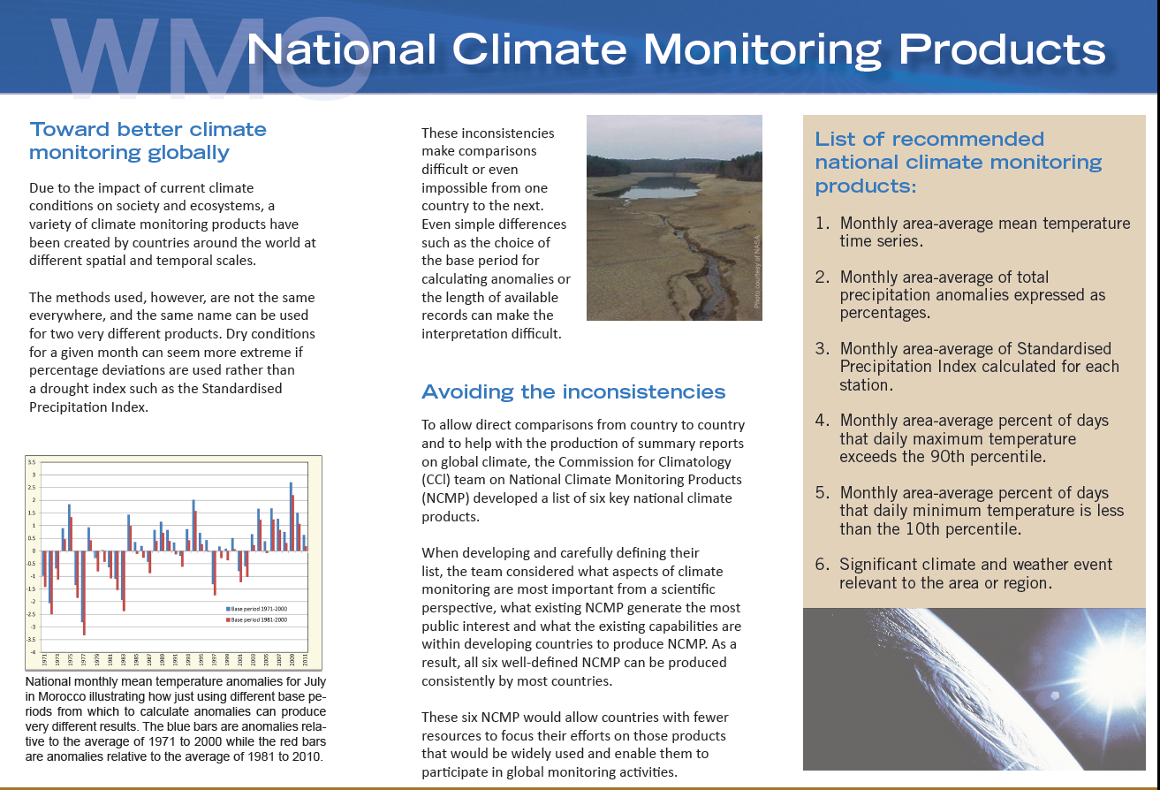
Main outcomes from the last intersession regarding NCMP:
  List of 6 NCMPs trough assessment of existing products
  Draft guidance for mainly the 5 first NCMPs
  Draft guidance for focal points
  Assessment of the possibility and importance of recommended software for calculation ➔ Climdex
  Calculation & spatial aspect: kriging method

Slide 6
Expected outcomes from this intersession
  - Develop/finalize the specifications of the NCMPs
  - including their provision
  and the associated software requirements,
  and develop/finalize guidance for their operational production and dissemination
  ➔ guidance, focal points, software, dissemination
  Assessment of the existing capabilities for NCMPs
  survey and workshops

Slide 7
Requested support from WMO for
  two face to face meetings during the actual intersession
  two workshops: assessment of capabilities & capacity development
  ➔Workshop specifications, needs
  targeted community? NCMP Focal points?, RCCs?, Particular region?

Slide 9
Expert Team on National Climate Monitoring Products
Terms of Reference
Develop the specifications of the NCMPs, including their provision and the associated software requirements, and develop guidance for their operational production and dissemination
Assessment of the existing capabilities for NCMPs including through survey and workshops
Collaborate with other groups such as the relevant CBS team regarding the creation, coding, implementation and the exchange of NCMPs
Collaborate with ETCCDI to assess the feasibility of, and provide –if appropriate- a methodology for, combining Rclimdex with appropriate gridding software to develop a unified NCMP software package for use on routine basis by the NMHSs

