Slide 1
Questions and suggestions about NCMP
Ayako Takeuchi, JMA
ET-NCMP meeting
(2015.9.15 – 2015.9.17, @Marrakech)

Slide 2
Self Introduction
Monitoring world climate by using CLIMAT and SYNOP data
GSN Monitoring Centre and CBS Lead Centre for GCOS Data
GSNMC: DWD (Germany) and JMA (Japan)
CBSLC: DMN (Morocco), INM (Mozambique), IRIMO (Iran), JMA (Japan), DMC (Chile), NOAA NCDC (USA), BOM (Australia), DWD (Germany) and BAS (UK)

Slide 3
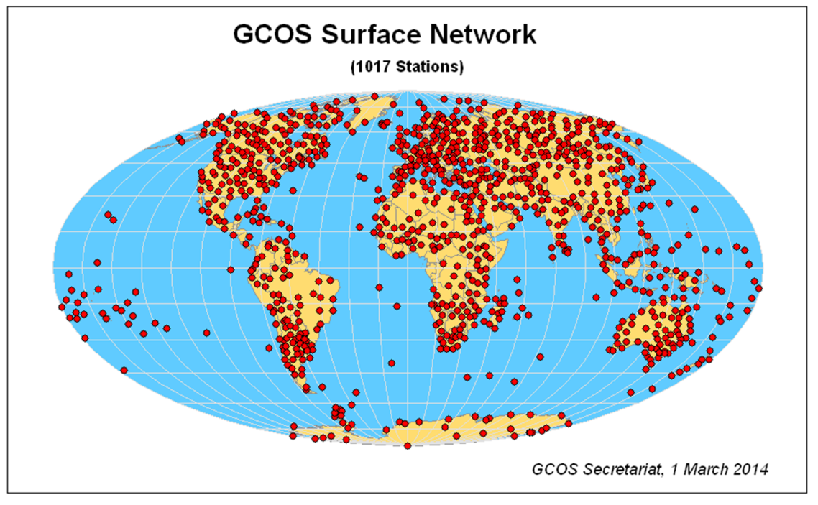
What is GSN?
GSN: GCOS Surface Network is minimum configuration for global climate monitoring (about 1,000 CLIMAT stations).
GCOS: Global Climate Observing System
GSN Monitoring Centre: DWD and JMA monitors availability and quality of CLIMAT reports from GSN stations.

Slide 4
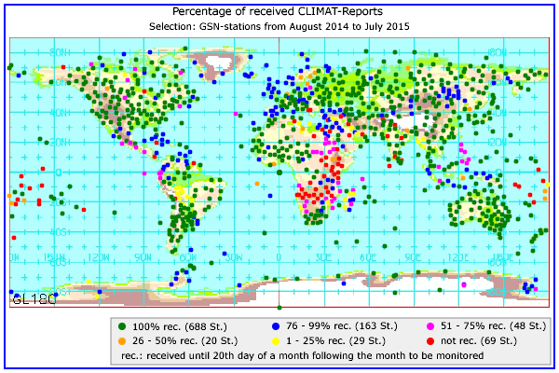
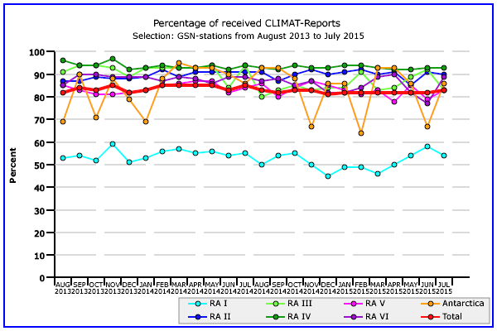
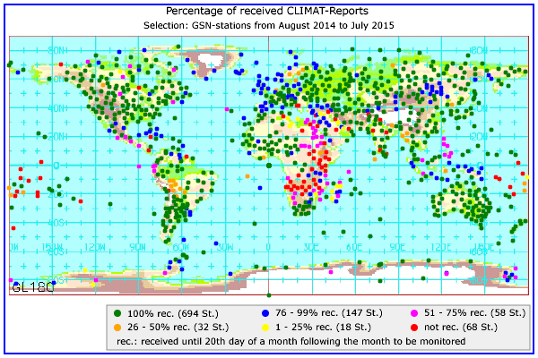
Monitoring results of GSNMC
Global: slightly above 80%
DWD
Graph: Percentage of received CLIMAT reports
DWD and JMA received for the last 24 months.
Maps: Percentage of received CLIMAT reports
from each station
DWD and JMA received for the last 12 months.
GSNMC website
http://www.gsnmc.dwd.de/
JMA

Slide 5
GSN and RBCN
GSN: GCOS Surface Network is minimum configuration for global climate monitoring (about 1,000 CLIMAT stations).
RBCN: Regional Basic Climatological Network is necessary to provide a good representation of climate on the regional scale, in addition to global scale (about 3,000 CLIMAT stations).
Percentage of received CLIMAT reports from RBCN stations is still about 70% (over 80% from GSN stations).
RBCN (WMO)
GSN (GCOS)

Slide 6
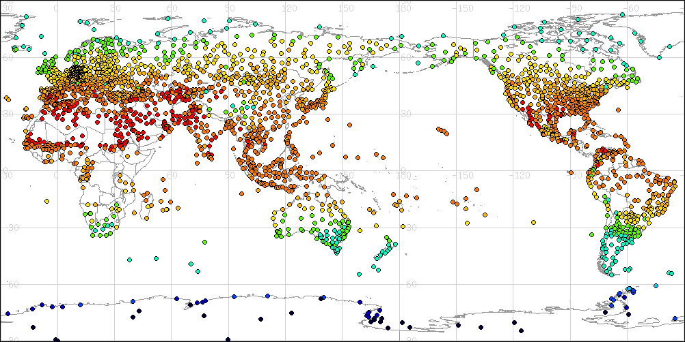
CLIMAT received in JMA (+DWD)
JMA receives about 2700 stations’ CLIMAT data.
About 1000/2000/2100 in 2700 CLIMAT reports include data of section 2/3/4.
Section 2, 3, 4 contain normal data, number of days with parameters beyond certain thresholds and extreme values and frequency of thunder storms and hails, respectively.
There might be difficulties in
data gathering
statistical calculation
encoding CLIMAT reports
putting reports into GTS
network problems in GTS
….
Monthly mean temperature (July 2015)
from the CLIMAT data received in JMA (+ DWD)

Slide 7
Questions
Should each NMHS calculate NCMPs? How about role sharing?
NMHSs report necessary data, someone (our team?) calculates NCMPs.
There may be problems in resources (computer and/or human), security and so on.
Can we modify the definition of NCMP to use existing data for NCMPs?
CLIMAT reports include some extreme values as well as monthly mean/total data.

Slide 8
Suggestion 1
For exchange of products, it is better to use a internet tool (web or e-mail), not through the GTS.
To put data into GTS, encodings are necessary.
For CLIMAT reports, mitigation to TDCF (Table-driven Code Forms) started in 2005, but at present only about 800 stations report BUFR CLIMATs.
There are other proposals to NMHSs regarding climatological data.
Collection of the WWR (World Weather Records) on an annual basis started in 2011.
It will be proposed to disseminate another BUFR data to report daily extreme values.

Slide 9
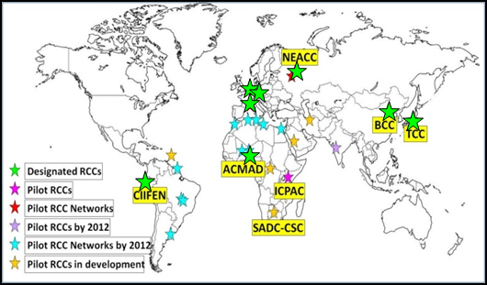
Suggestion 2
It should be better to collaborate Regional Climate Centres (RCCs) that support NMHSs in each region.
In JMA, Tokyo Climate Center (TCC) was established in 2002 to support climate services in the Asia-Pacific region and designated as an RCC in 2009.
Its major activities are
providing climate data and products to NMHSs through the website
assisting with capacity building at NMHSs in the region (annual training seminar)

Slide 10
I think that dissemination of basic climatological data like CLIMAT is the most important and makes many communities happier.
Thank you.

Slide 11
Backup Slides

Slide 12
Contents of CLIMAT report
Monthly data
Mandatory!
Normal data
Number of days with parameters beyond certain thresholds
Extreme values and frequency of thunder storms and hails
“Manual on Codes” (WMO Publication No. 306) http://www.wmo.int/pages/prog/www/WMOCodes/WMO306_vI1/Publications/2014update/Sel4.pdf
This code form can be found in 1995 edition.

Slide 13
TCC Annual Training Seminar
As part of TCC’s capacity-building activity in its role as RCC, TCC holds annual training seminars on the application of its climate monitoring and prediction products.
Each seminar deals with a different theme depending on TCC’s progress in climate and analysis capabilities, such as the introduction of upgraded climate models.
 | Theme | Participants
Nov. 2008 | Climate Information and Forecasting | 13: China, Hong Kong, India, Indonesia, Iran, Korea (2), Lao, Malaysia, Mongolia, Philippines, Thailand, Viet Nam
Dec. 2009 | Climate Analysis using Reanalysis Data | 11: Bangladesh, Indonesia, Laos, Malaysia, Mongolia, Pakistan, Papua New Guinea, Philippines, Sri Lanka, Thailand, Viet Nam
Jan. 2011 | Application of Seasonal Forecast Gridded Data to Seasonal Forecast Products | 19: Bangladesh, Hong Kong, Indonesia, Kazakhstan, Laos, Malaysia, Maldives, Myanmar, Nepal, Pakistan, Philippines (2), Qatar, Singapore, Sri Lanka, Thailand, Uzbekistan, Viet Nam
Nov. 2011 | One month Forecast Products | 13: Bangladesh, Cambodia, Hong Kong, Indonesia, Laos, Malaysia, Mongolia, Myanmar, Pakistan, Philippines, Sri Lanka, Thailand, Viet Nam
Nov. 2012 | Climate Analysis Information | 12: Bangladesh, Hong Kong, Indonesia (2), Laos, Malaysia, Mongolia, Myanmar, Nepal, Philippines, Sri Lanka, Thailand, Viet Nam
Nov. 2013 | Seasonal Forecast Products | 16: Bangladesh, Cambodia, Hong Kong, Indonesia (3), Laos, Malaysia, Mongolia, Myanmar, Nepal, Papua New Guinea, Philippines, Sri Lanka, Thailand, Viet Nam
Jan 2015 | Global Warming Projection Information | 13: Bangladesh, Cambodia, Indonesia, Hong Kong, Laos, Malaysia, Mongolia, Myanmar, Nepal, Philippines, Sri Lanka, Thailand, Viet Nam
Nov 2015 (scheduled) | One Month Forecast | 15: Bangladesh, Cambodia, Indonesia, Hong Kong, Laos, Malaysia, Mongolia, Myanmar, Nepal, Pakistan, Philippines, Singapore, Sri Lanka, Thailand, Viet Nam
http://ds.data.jma.go.jp/gmd/tcc/tcc/library/index.html

