Slide 1
UK NCMP
John Kennedy
ET-NCMP meeting Marrakech,
5-7 March 2018

Slide 2
UK Stations
31 Stations
A subset of the full network
Reasonable coverage except upland areas of Scotland
Quite a lot of missing days particularly for precipitation
Data had already been Quality Controlled

Slide 3
UK Stations
Good coherence at annual time scales
Coherence best for mean temperature
Precipitation generally more variable
Cold nights possibly inhomogeneous

Slide 4
Variograms - PrAn

Slide 5
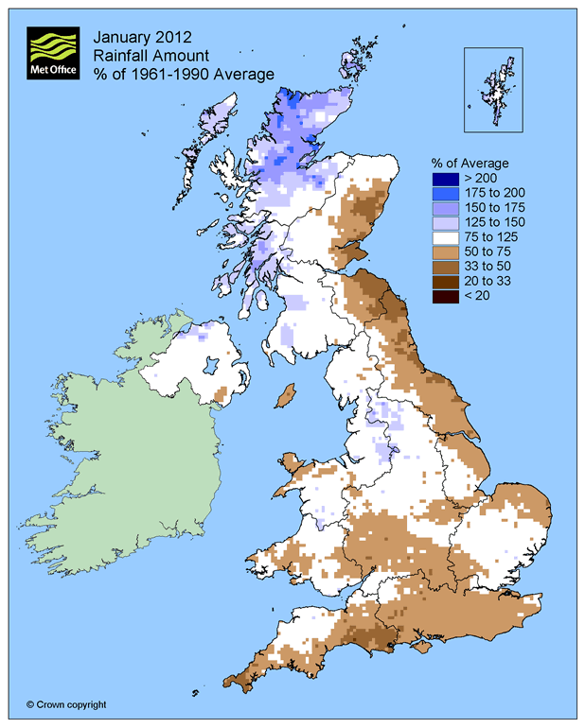
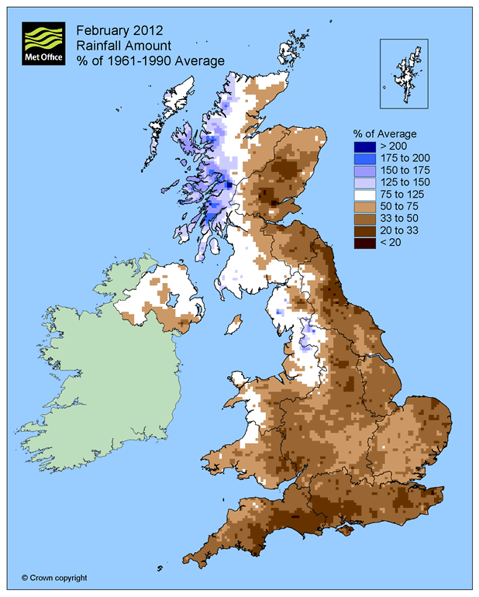
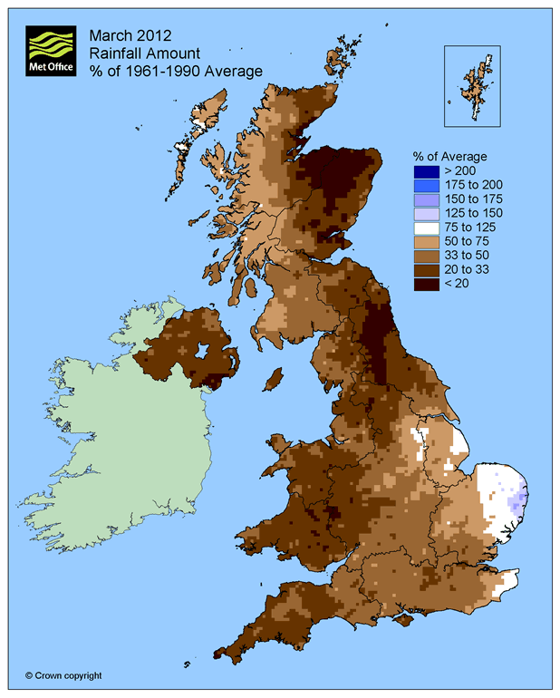
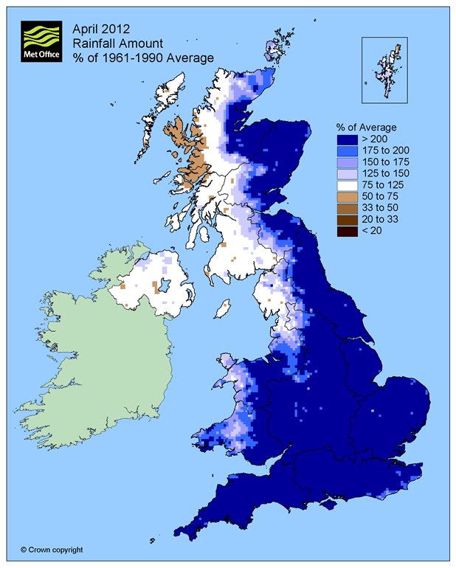
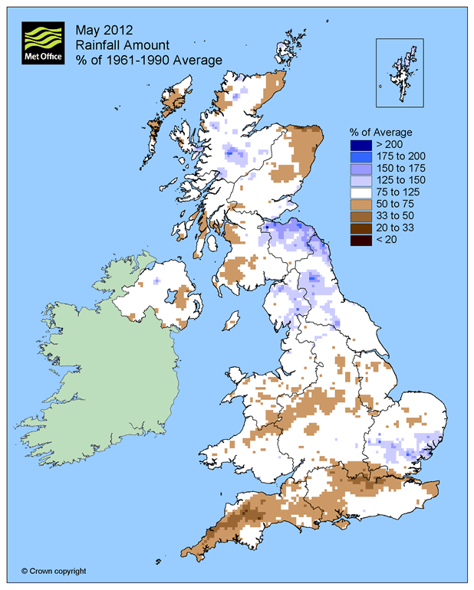
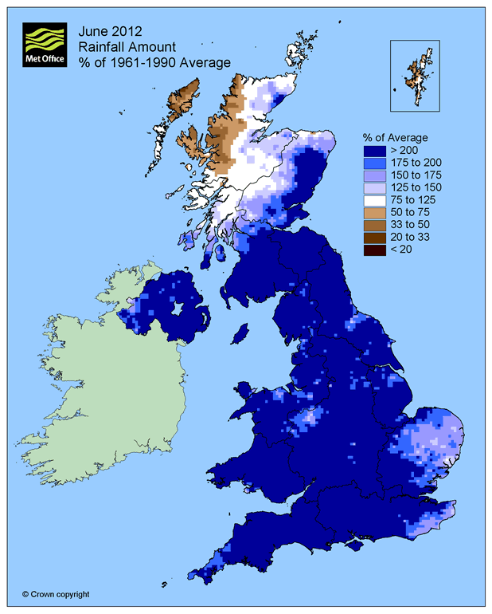
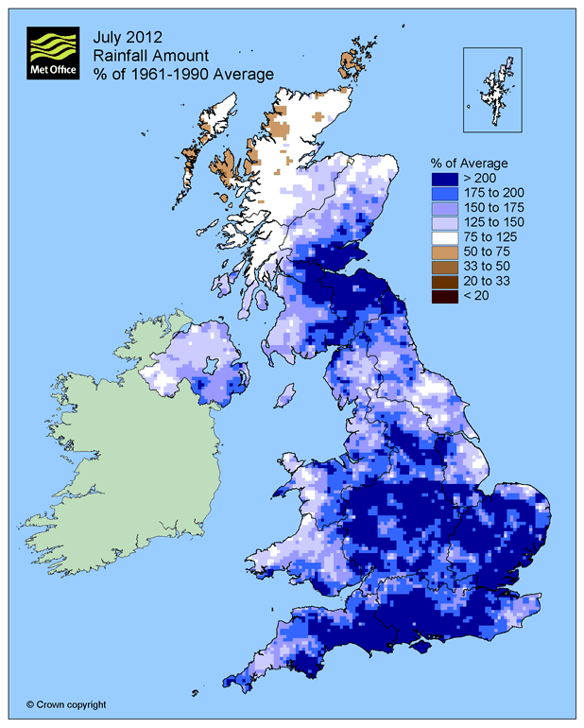
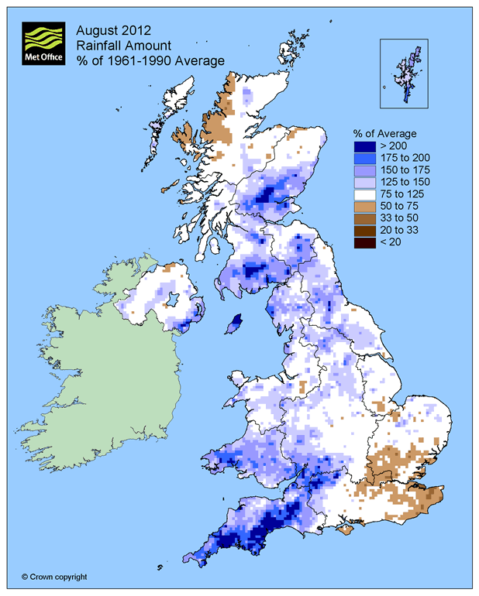
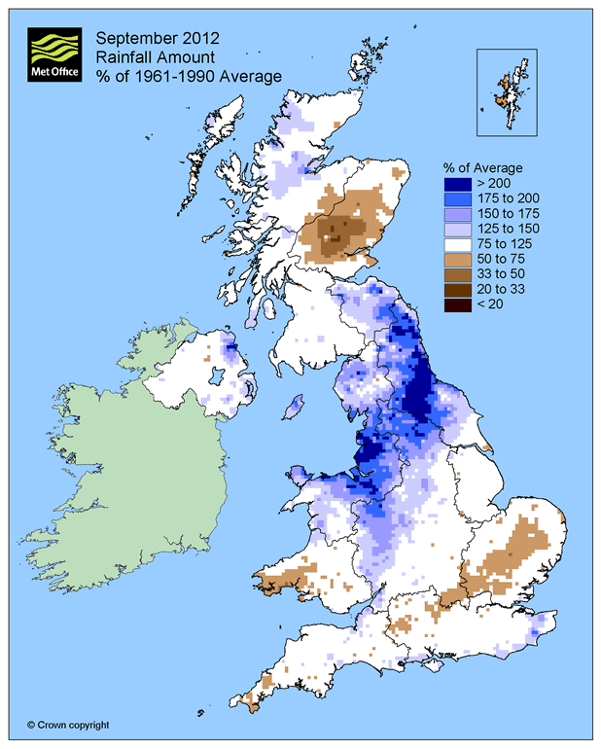
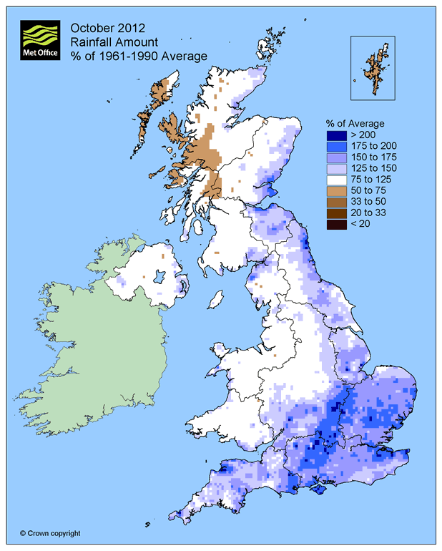
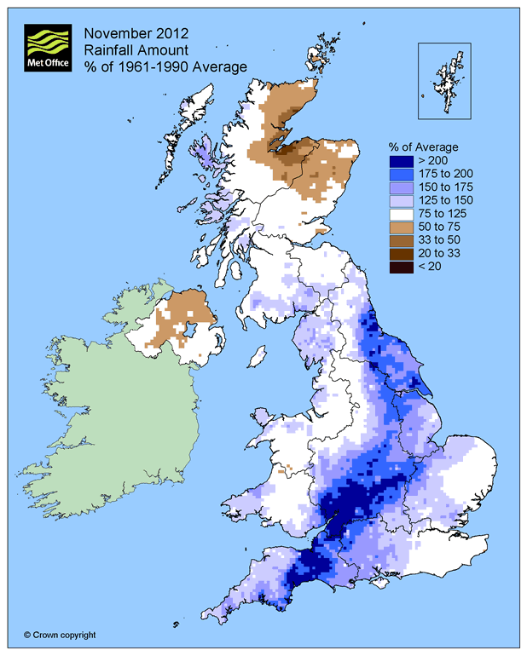
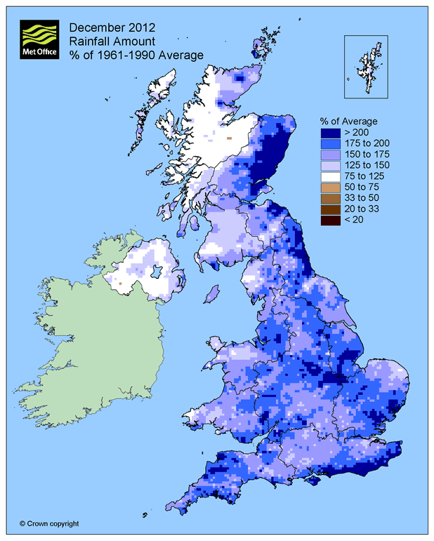
Maps

Slide 7
Things that came up
Precipitation anomaly calculation numerically unstable [Quick fix: divide by 100]
Had to modify the missing data allowances
NCMP4 and 5 are warm days and cold nights, but the code has cold days and warm nights as well. Could be confusing.
Parts of the UK were “clipped”
PrA, PrAn and SPI were very similar for the UK
A4 won’t allow calculation of index 8.
P4_Regional_Average asks for country number, regional or national average every time. Could be set up at start in a configuration file.

