Slide 1
ET-NCMP
Palm Plaza Hotel, Marrakech
15 September 2015

Slide 2
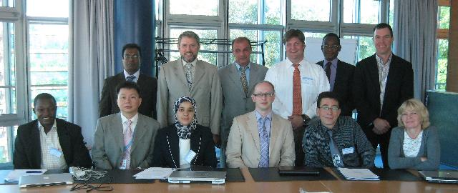
Task Team NCMP

Slide 3
Task Team
Surveyed NHMS web sites and publications to gather examples of NCMPs
Drafted a survey for circulation to NHMSs
Created a short list of the NCMPs
Made decisions about
  baselines
  need for software and workshops
Chose general method to interpolate data.
Drafted basic guidance
Liaised with CBS on messages and formatting

Slide 4
Baselines
Two basic choices: 1961-1990, 1981-2010
Consistent with WMO guidance on normals
For monitoring products, need to ensure that products can be updated.
Baseline can be specified in the code
Need stations that are open now.
A long record is important for context, but this is a secondary consideration
On balance, a 1981-2010 baseline is preferred.

Slide 5
Software and Workshops
Consistency is difficult to ensure
Even detailed guidance can be implemented in a variety of ways.
Providing a standard set of software minimises the possibility of discrepancies
Even with software, there is still a need for workshops so that people understand how to appropriately use the software.

Slide 6
Homogenisation
Homogenisation is a complex task
While it is important, it is outside of the remit of this group to solve that problem
We can recommend that station data are homogenised, or that only homogeneous segments of data be used

Slide 7
Interactions with IPET-DRMM
Inter-programme Expert Team on Data Representation Maintenance and Monitoring
The chair briefed the outcome from the Expert Team on Assessment of Data Representation Systems (ET-ADRS) in 2008, which was inter-commission initiative. The team did swot analysis to review the applicability of formats, such as BUFR, GRIB, netCDF, HDF, ASM1, XML, Common Alerting Protocol (CAP). According to the outcome, the stakeholders, such as journalists, will be better served not with BUFR.
The Secretariat said BUFR could be used primarily within WWW community for operational meteorology. Journalists were moving very very rapidly into XML.
The chair concluded that opportunity should be kept open to different users, and agreed that the team could show CCl how to represent the data in BUFR. The Secretariat informed of one example on XML development, which was being done by TT-AvXML. It could make one format to the other easily.
With respect to collaboration with the Commission for Climatology (CCl) on the National Climate Monitoring Product (NCMP), the meeting stated that IPET-DRMM will assist CCl in developing a BUFR template for NCMP that has been initiated by the Australian Bureau of Meteorology.
It was pointed that extreme events in the product No. 6 (in Mr Arndt's presentation) were expressed in free texts but it was not convenient from coding perspective. In response to the concern, it was notified that drafting a template for NCMP was initiated in BoM last year after the previous meeting of IPET-DRMM and in the draft the event types and values (max, mean ...) are incorporated in code tables.

Slide 8
Terms of Reference
Develop the specifications of the newly defined National Climate Monitoring Products (NCMPs), including for their provision and the associated software requirements, and develop guidance for their operational production and dissemination;
Conduct an assessment of the existing capabilities for national climate monitoring, including through surveys and workshops;
Collaborate with other groups such as the relevant CBS teams regarding the creation, coding, implementation and the exchange of NCMPs, obtain feedback on NCMP implementation from suitable points of contact in NMHSs, and liaise with World Data Centres as appropriate on scientific and technical guidance;
Collaborate with ETCCDI to assess the feasibility of, and provide –if appropriate- a methodology for, combining RClimDex with appropriate gridding software to develop a unified NCMP software package suitable for use on routine basis by the NMHSs.

Slide 9
Short list of NCMPs
Mean temperature anomaly, area-averaged
Percentage of normal rainfall, area-averaged
Standardised Precipitation Index, area-averaged
Number of days with Tmax > 90th percentile, area-averaged
Number of days with Tmin < 10th percentile , area-averaged
Indicator for extreme events

Slide 10
Guidance
Aim is that all countries can produce NCMPs in a consistent manner
Guidance has to describe the NCMP generation in detail
Include information on formats, which can describe the NCMPs and provide metadata so that their relative reliability can be assessed.

Slide 11
ET-NCMP
Survey
Letter for nomination of focal points
List of contacts
Draft guidance

