Slide 1
R-NCMP software: U.S. testing
Jessica Blunden ET-NCMP Meeting Marrakech, Morocco
5-7 March, 2018
National Oceanic and Atmospheric Administration | NOAA Satellite and Information Service

Slide 2
Preparation and Input
Selected 48 stations for testing:
1 from each state in the contiguous U.S.
Stations with longest Periods of Record were selected
Followed examples in User’s Manual
Unsure about years to use in Variogram: followed examples in manual (starting 1981, ending 1982)
Received a lot of errors here, not sure why or how to resolve.
Guidance would be useful for how many years to include for variaogram calculation.

Slide 3
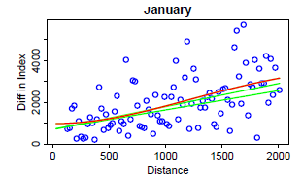
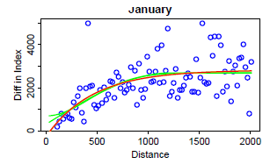
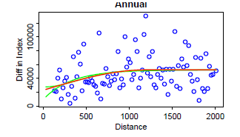
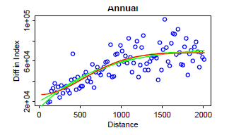
Variograms (Temperature)
Start: 1981 End: 1982
Start: 1981 End: 2010
Notes:
Much better overall to use many years.

Slide 4
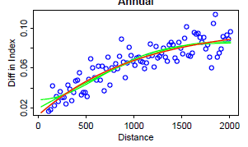
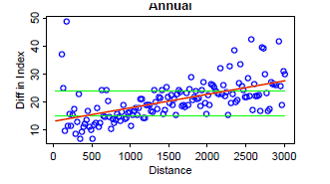
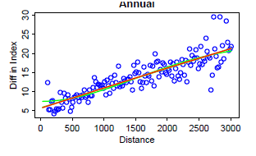
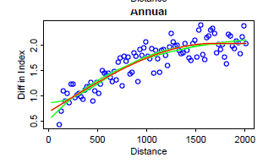
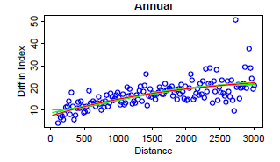
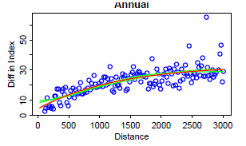
More Variograms
(1981-2010 selected)
PrAn
TN10p
TX10p
SPI
TN90p
TX90p

Slide 5
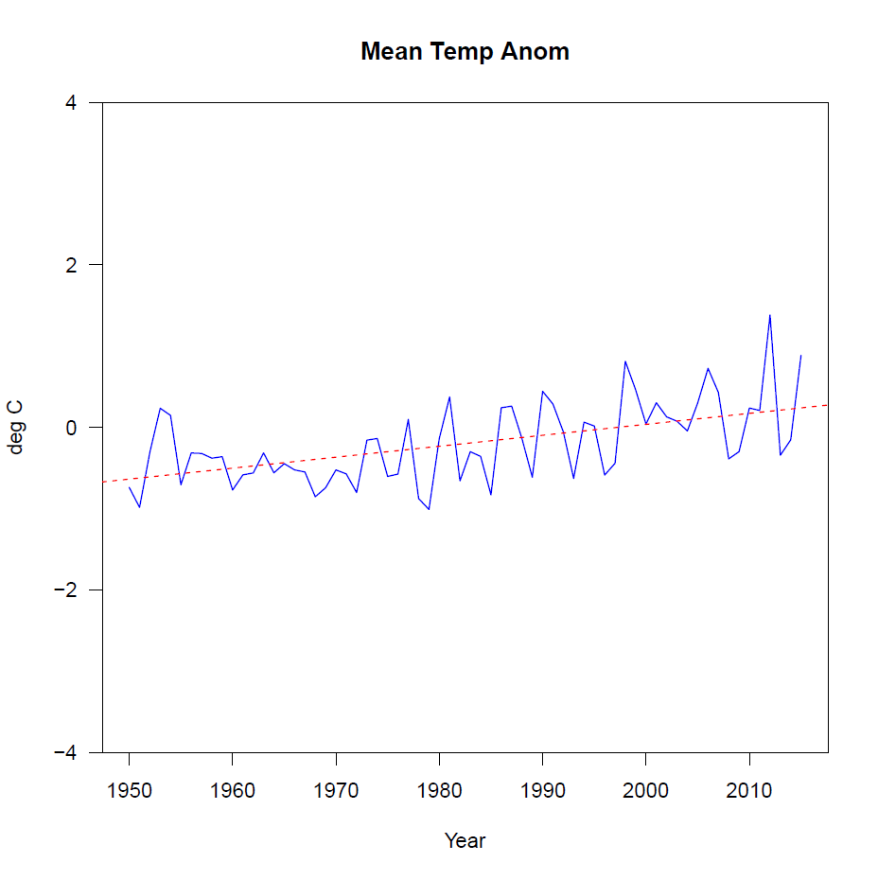
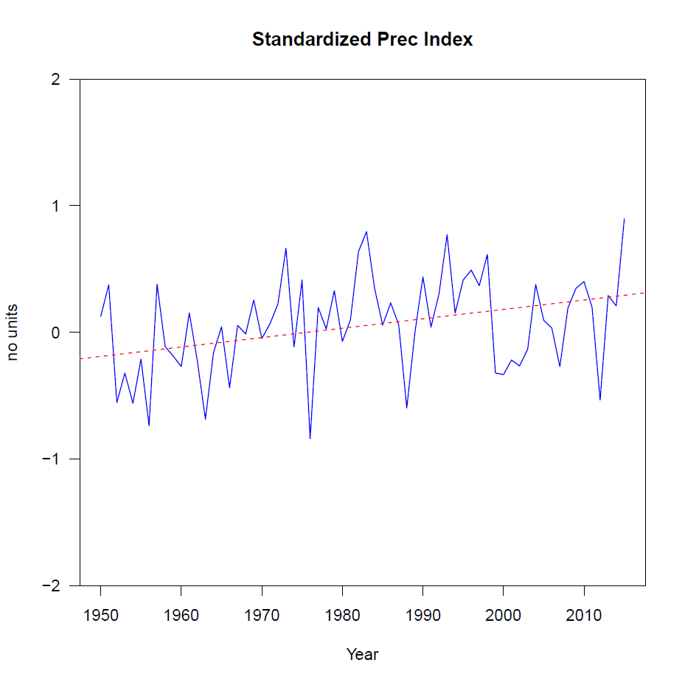
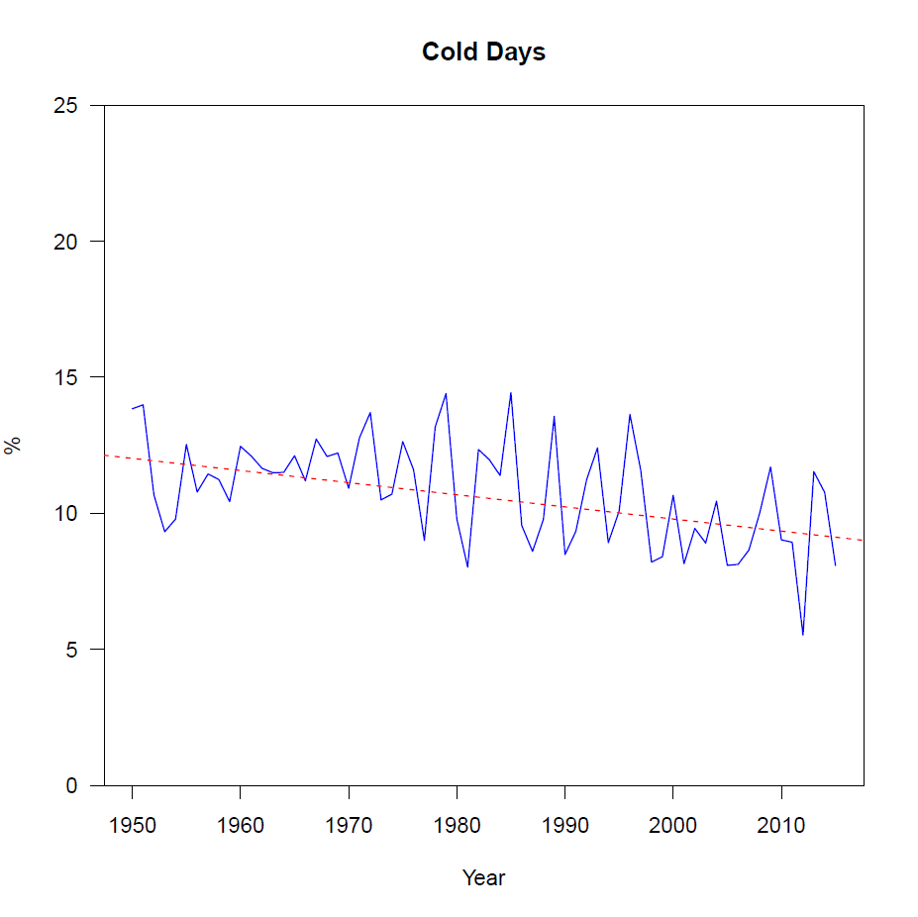
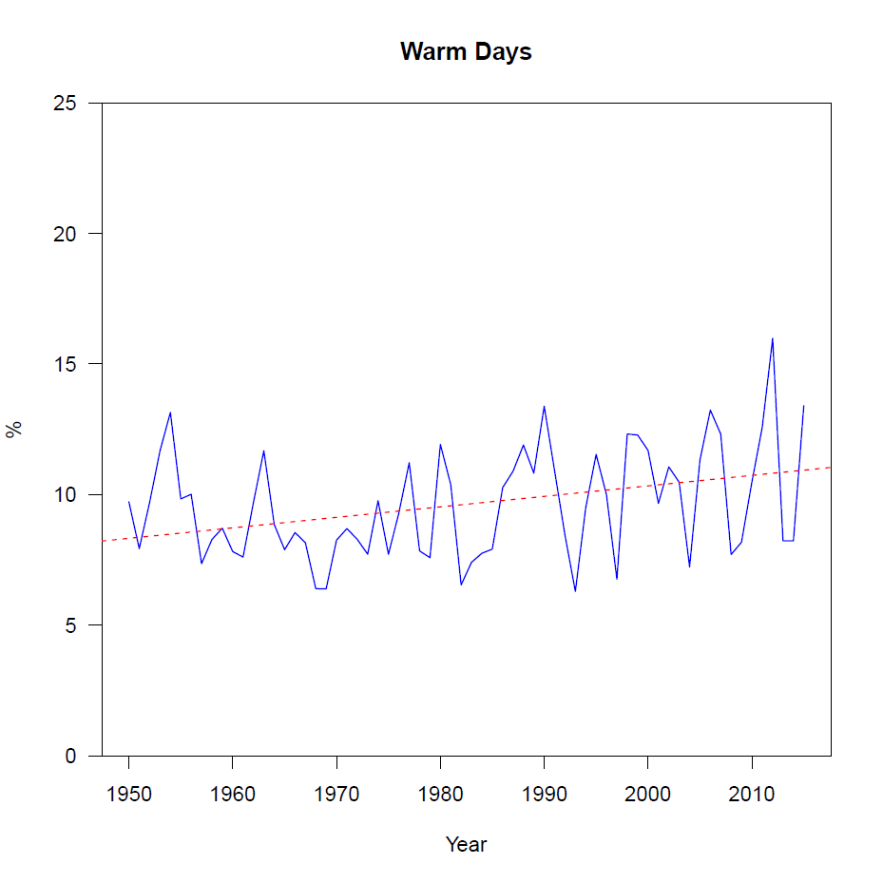
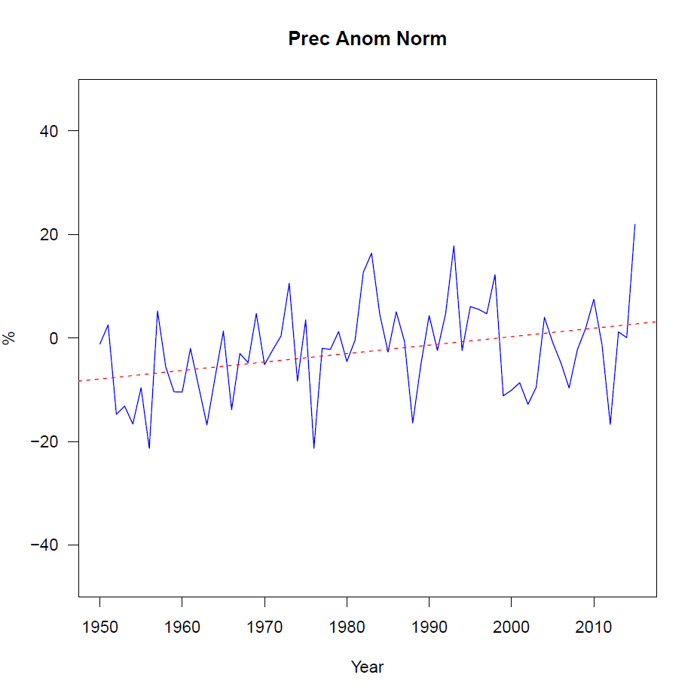
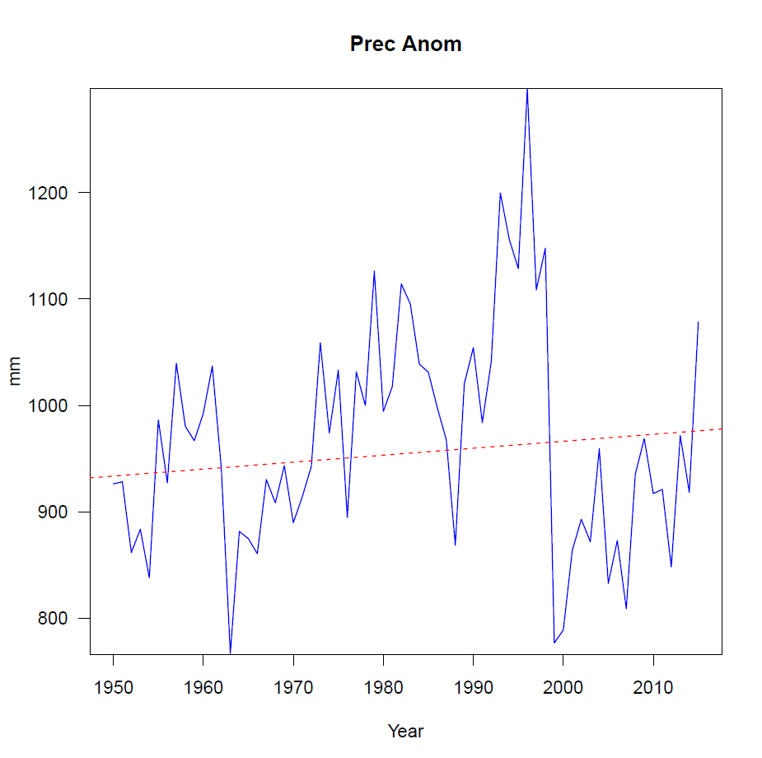
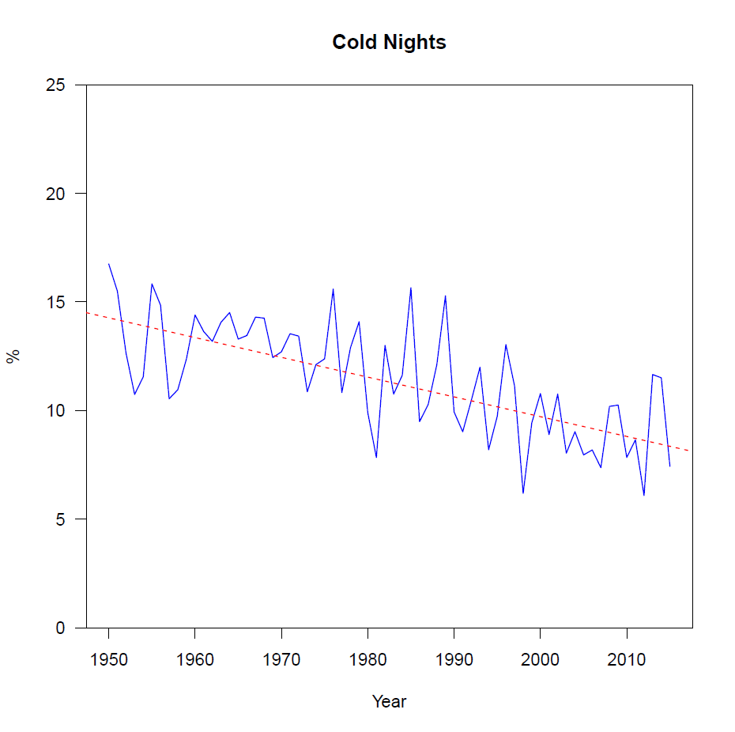
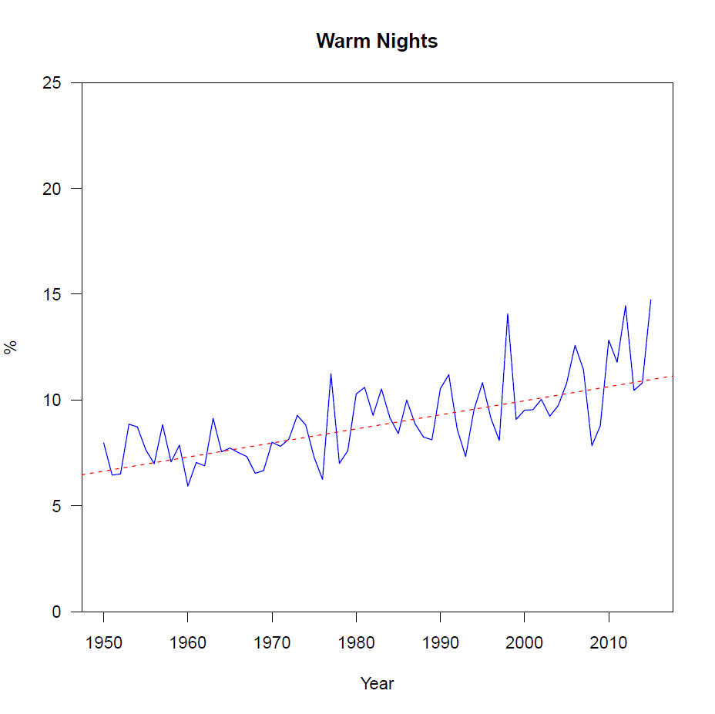
Trend Graphs

Slide 6
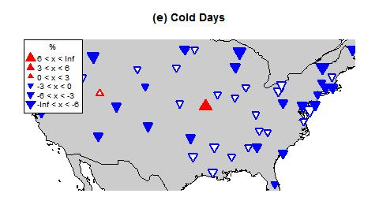
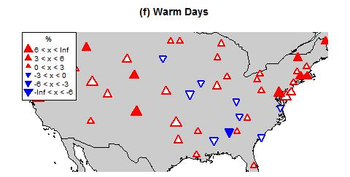
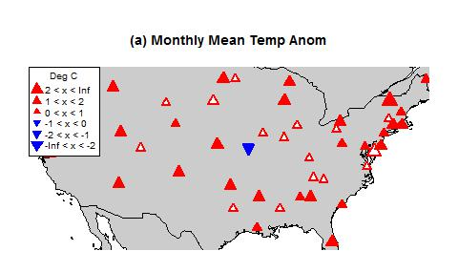
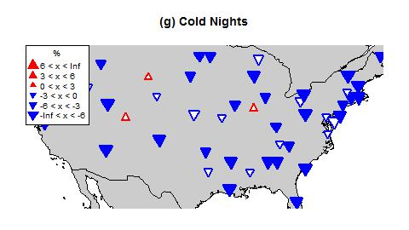
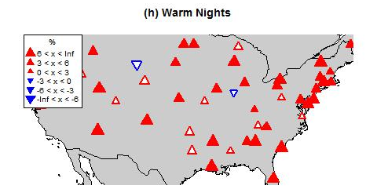
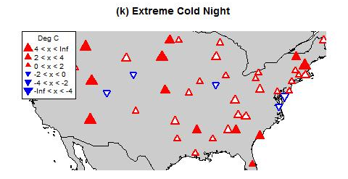
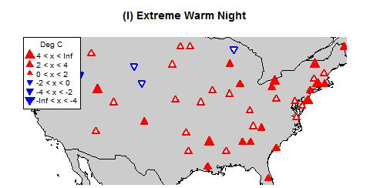
Maps

